Slide 1
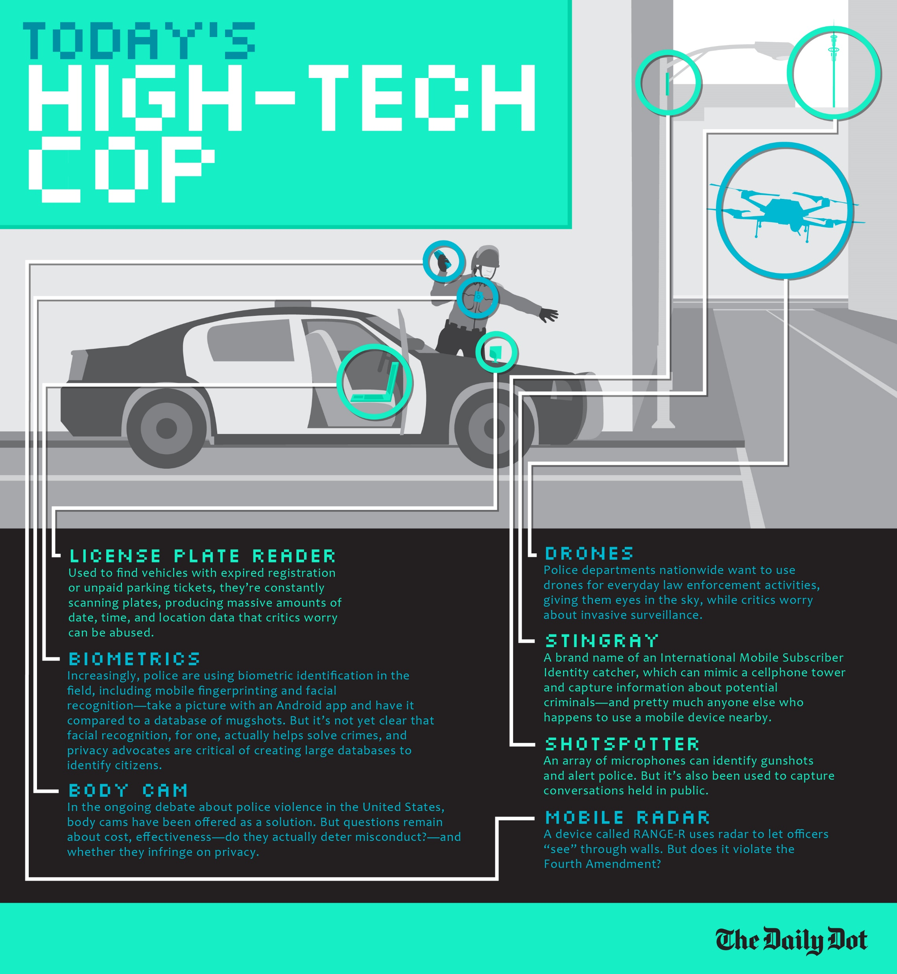
Hot Spots

Slide 2
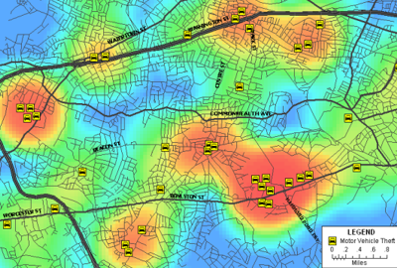
Hot spots

Slide 3
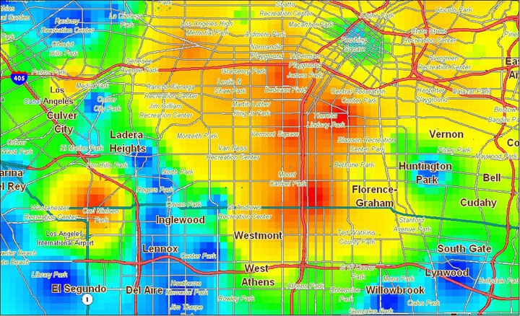
Hot spot policing
a method of police patrol that focuses on small geographical areas where crime is concentrated;
Crime data is fed into geographically mapping systems that show how the volume of crime is distributed within and across neighbourhoods;
this is one of the best tested of theories in policing and community safety and is therefore frequently cited as an example of a theory with a strong evidence base.

Slide 4
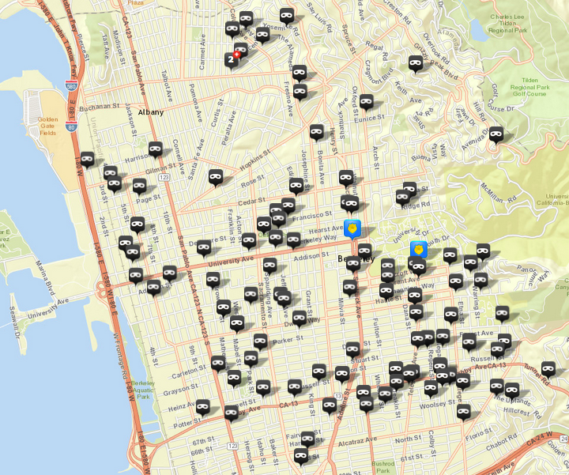
Crime analysis and proactive policing with burglaries
since burglars often return to re-victimize particular places and neighbourhoods, creating area ‘hot spots’ and ‘hot zones’, police agencies can effectively identify at-risk areas and target them through increased presence, thereby increasing the chances of catching perpetrators and/or decreasing the risk of further criminal events.

Slide 5
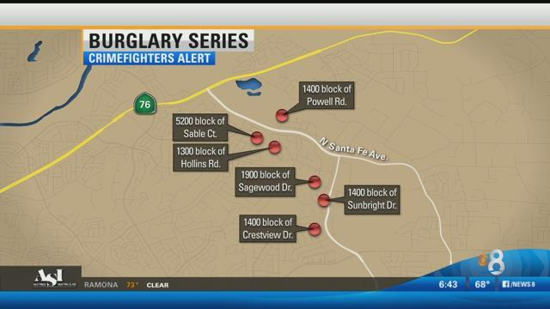
Another fact about burglary hotspots
near repeats – once a home or apartment in an area has been burglarized, nearby residences or structures are at increased risk of becoming victimized because it signals to the offender that this is a ‘safe’ neighbourhood within which to commit further offences. Once a home in a neighbourhood has been victimized, subsequent victims in the area are termed a ‘near repeat’ (Morgan 2000).

Slide 6
Crime prevention tactics
by understanding how burglaries can generate ‘repeats’ and ‘near repeats’, police can work to increase awareness of residents and businesses of area burglaries and provide crime prevention information to assist with target hardening, area surveillance and crime reporting.

