Slide 1
Problem oriented policing (focusing on problem solving)

Slide 2
Problem-Oriented Policing and Problem Solving
Problem-Oriented Policing describes a comprehensive framework for improving police capacity to perform their mission.
Problem Solving is a more limited notion; it describes the research process that is at the core of problem-oriented policing.

Slide 3
Wait … research? Isn’t that Evidence Based Policing?
POP: Problem-oriented policing is an analytic method used by police to develop strategies that prevent and reduce crime (NIJ 2020)
EBP: The use of scientific research to develop and test new policing strategies and policies. There can be a focus on preventing and reducing crime, but EBP is a more holistic approach that also considers other non-crime and disorder related policing issues, such as police recruitment, training, effective leadership and so on.
These two approaches are complementary to one another.

Slide 4
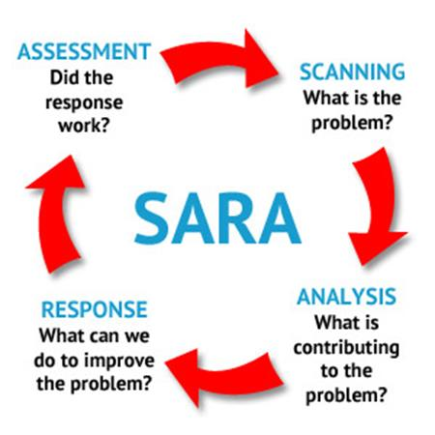
The SARA model

Slide 5
Scanning
Identifying recurring problems
Prioritizing the problems
Developing goals
Confirming that the problems exist
Determining how often the problem occurs and how long it has been a concern
Selecting problems for closer examination

Slide 6
Methods of Identifying Problems
Reviewing police reports
Surveying the community
Reviewing citizen complaints
Participating in community meetings
Reviewing information from neighborhood associations and nonprofit organizations
Consulting social service/governmental agencies

Slide 7
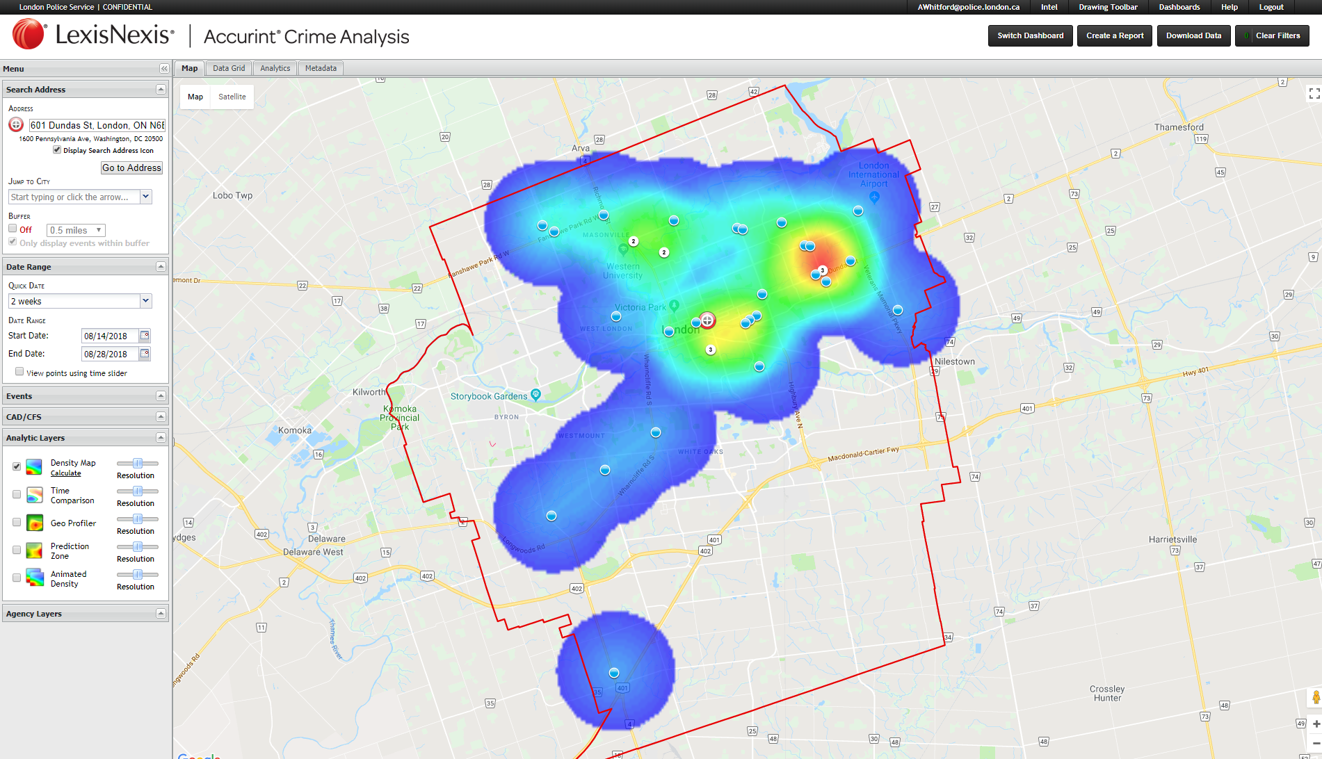
Analysis
Identifying and understanding events and conditions that precede and accompany the problem
Identifying relevant data to collect
Researching what is already known about the problem type
Taking inventory of how the problem is being addressed and any strengths/limitations of the current response
Narrowing the scope of the problem
Identifying resources that may be of assistance in developing a deeper understanding of the problem
Developing a working hypothesis about why the problem is occurring; is it really occurring?

Slide 8
Why do Police Services Sometimes Skip Analysis?
The nature of the problem sometimes falsely appears obvious at first glance (the ‘common sense fallacy’).
There may be some tremendous internal and external pressure to solve the problem immediately.
The pressure of responding to calls does not seem to allow for time for detailed inquiries into the nature of the problem.

Slide 9
Response
Brainstorming for new interventions
Searching for what other communities with similar problems have done
Choosing among the alternative interventions
Outlining a response plan and identifying responsible parties
Stating the specific objectives for the response plan
Carrying out the planned activities

Slide 10
Assessment
How do you know what you did worked?
The Test
Also explore possibility of ‘backfire effects’ (ie. that your intervention might have made things worse or created new problems).

Slide 11
*break time*

