Slide 1
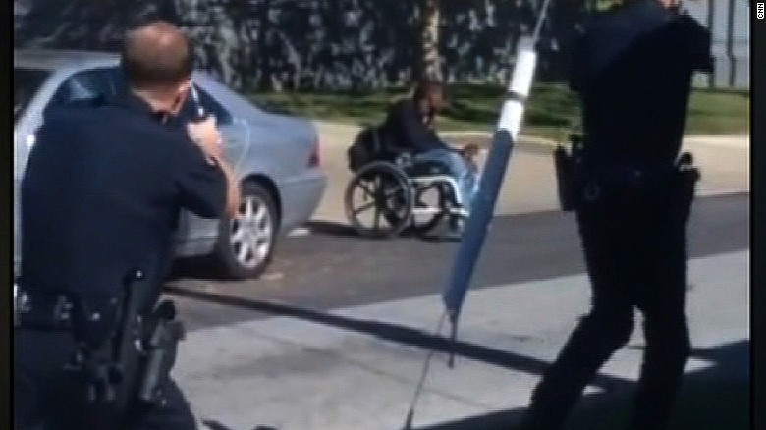
Unfounded

Slide 2
Sexual assault – unfounded cases

Slide 9
So, what happened?

Slide 10
Studies to consider:
Canada:
McCormick, Haarhoff, Cohen, Plecas and Burk 2012
US:
Hickman and Poore 2016
UK:
Brimicombe 2016

Slide 11
*break time*

