Slide 1
Evidence Based Policing
“Police practices should be based on scientific evidence about what works best”
Lawrence Sherman (1998)

Slide 2
Definition
Evidence based policing (EBP):
a research approach that focuses attention on both the methods used to conduct research as on how research findings will later be used by police agencies.
The goal of EBP? To develop quality research to answer the question ‘what works?’ in order to develop sound policing strategies, policies and/or programs.

Slide 3
Origins of EBP
EBP was developed by Lawrence Sherman (1998).
Sherman spent years studying policing innovations in
the field. Looking at what was going on in the police world, he noted many policing programs were built on un-tested assumptions (experience, anecdote, etc.). He turned to the science of medicine for inspiration in developing a new body of policing research.
In medicine, new clinical treatments are tested using a scientific method known as the ‘randomized control trial.’
For Sherman, policing strategies aimed at crime problems related to specific types of offenders, victims and/or places should ideally be tested using randomized control trials.

Slide 4
4 key ideas embodied in EBP:
1. scientific research has a role to play in developing effective and efficient policing programs;
2. research produced must meet standards of methodological rigor and be useful to policing;
3. results should be easily translatable into everyday police practice and policy, and;
4. research should be the outcome of a blending of police experience with academic research skills.

Slide 5
Evidence + experience = expertise
EBP incorporates the police in the research process.
as co-creators of projects (helping to develop topics, research questions, refine methods, etc.)
as co-investigators on research teams (conducting research and/or analyzing results)
serve as advisors during the research process (providing advice
and feedback while projects are ongoing)
and/or provide crucial feedback on study results and recommendations.

Slide 6
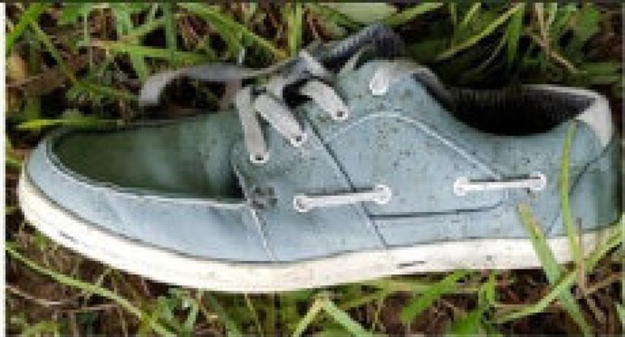
Hrm. What about data? What’s the diff between data & evidence? Why can’t I just use my data?
Data is just data and has no meaning on its own.
Evidence is an interpretation of data – it has to be evidence for or of something; an argument, an opinion, a point of view or, if you wish to be all science-y, a hypothesis.
You can think of it this way:
what’s the difference between a clue and evidence in policing?

Slide 7
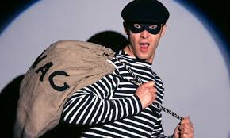
So, what do we do with this EBP stuff?
develop a better understanding of an issue - by describing the nature, extent and possible causes of a problem or looking at how a change was implemented;
assess the effect of a policing intervention - by testing the impact of a new initiative in a specific context or exploring the possible consequences of a change in policing.

Slide 8
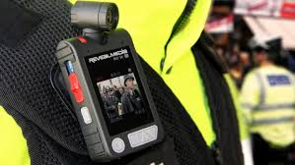
EBP topics
Police leadership
Domestic abuse programs
Body worn cameras
Victim contact programs
Offender diversion programs
Traffic safety initiatives
Police workload issues
Foot patrol
Peer support programs for police officers
Prioritization strategies for offender targeting
Hot spot policing
Emotional intelligence testing for new recruits

Slide 9
The Triple T strategy
In 2013 Sherman incorporated his ‘triple T’ strategy into EBP:
Targeting – identifying a high priority policing problem (ie. a place, crime pattern, type of offense)
Testing – police strategies to fix the problem should
be tested through scientific research to make sure they
work (ie. reduce crime, increase arrests, improve
community satisfaction).
Tracking – once in place, solutions should be tracked over time to ensure they continue to work and, when needed, to make changes.

Slide 10
Our obsession: “what works”

Slide 11
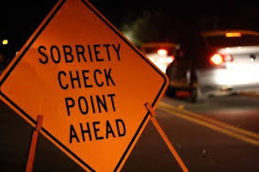
Example: sobriety checkpoints
Research on sobriety checkpoints consistently finds they reduce rates of alcohol related deaths and injuries on the roads.
In other words, the research says sobriety check programs ‘work’ and, in theory, they ‘work’ everywhere (subject to the need to make some small changes to account for local conditions and resources).
Therefore, if police want to cut road accidents during the holiday season, setting up checkpoints is a good idea.

Slide 12
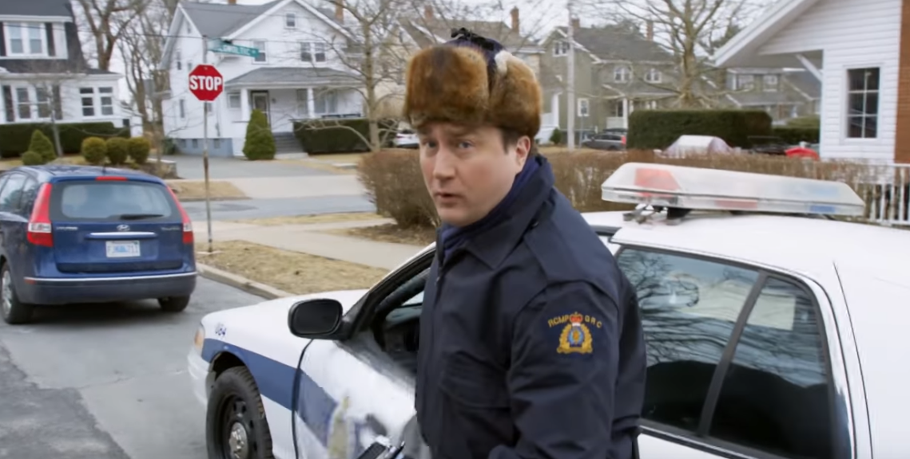
Canadian pot sobriety checks
https://www.youtube.com/watch?v=2PLC_cBJwk4

Slide 13
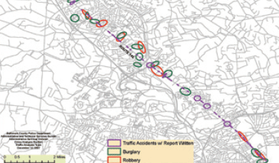
Works – directed patrols
the use of intensive patrols in neighbourhoods or in defined police beats to combat serious crime issues.
During high risk periods, assigned officers engage in highly visible proactive measures (such as traffic enforcement).
Often used in the US to deal with gun-related offences.
Great example: Baltimore’s Crash-Crime Project (they mapped crime data to car crash sites on the theory that many crashes involved illegal activities). They then targeted corridors where both occurred. A later project targeted displacement areas.

Slide 14
Ideas under trial (that look v. promising)

Slide 15
What’s the most popular type of video on YouTube?

Slide 16
Positive, targeted crime prevention messaging
#copcat

Slide 19
Also obsessed with: what doesn’t work

Slide 20
Doesn’t work – DARE programs
Drug Abuse Resistance Education programs geared towards encouraging youth to desist from using illegal drugs, joining gangs and/or engaging in violent activities.
From Scientific American:
If you were one of millions of children who completed the Drug Abuse Resistance Education program, or D.A.R.E., between 1983 and 2009, you may be surprised to learn that scientists have repeatedly shown that the program did not work. Despite being the nation’s most popular substance-abuse prevention program, D.A.R.E. did not make you less likely to become a drug addict or even to refuse that first beer from your friends.
In 2014, the US rolled out a “new DARE program.”

Slide 21
How EBP can help: Crime concentration, procedural justice and the death of Sandra Bland

Slide 22
https://www.youtube.com/watch?v=aGnENyG3Aq4

