Slide 1
What does it mean to be ‘evidence based’?

Slide 2
What is evidence? What is data?
Data is just data and has no meaning on its own. Eg. 12% of people like Cheetos. Um … so what?
Evidence is an interpretation of data – it has to be evidence for or of something; an argument, an opinion, a point of view or, if you wish to be all science-y, a hypothesis.
You can think of it this way:
what’s the difference between a clue and evidence in those CSI
shows you all love?

Slide 3
What constitutes ‘best evidence’?
The 'best available evidence will use appropriate research methods and sources for the question being asked.
Research should be carefully conducted, peer reviewed and transparent about its methods, limitations, and how its conclusions were reached.
Where there is little or no formal research, other evidence such as professional consensus and peer review, may be regarded as the 'best available', if gathered and documented in a careful and transparent way.

Slide 4
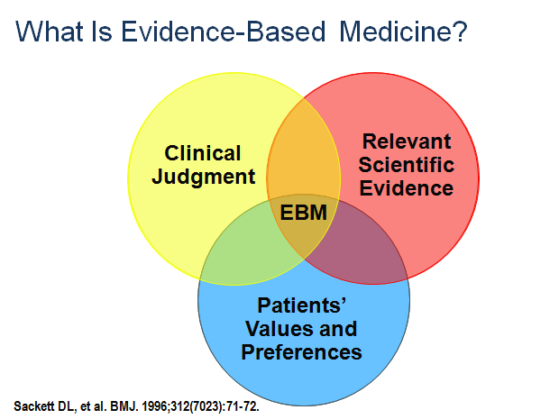
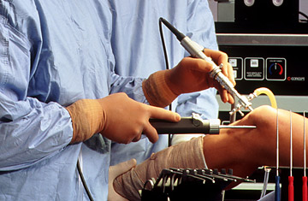
Evidence Based Movements
Medicine
Management
Policing
Nursing

Slide 5
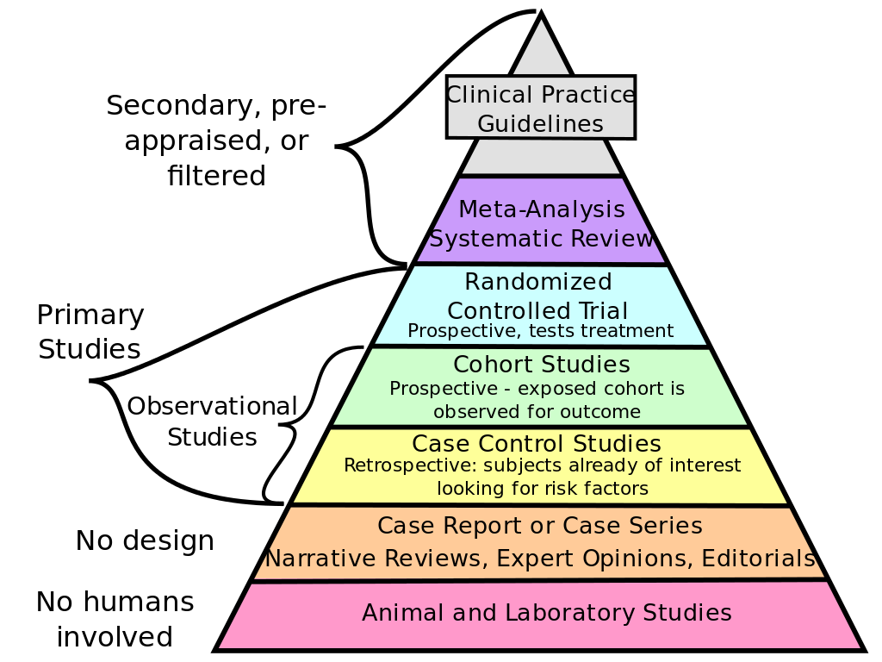
What is an “evidence base”?
Too often, people think evidence based means you base your decision on the results of a study (you either commissioned or selected). Let’s see why that might be a bad idea.

Slide 8
Why math (which I hate) and logic (which I love) are my friends:
UK Census data (2014) courtesy of the Office of National Statistics:
64.1 million people in the UK (233 men and women aged 60+ murdered)
Males aged 75: 218, 365 (39 men aged 75+ murdered)
Males aged 75: 250, 767 (61 women aged 75+ murdered)
In this context, do we want to rethink the framing of this story? Jes sayin’

Slide 17
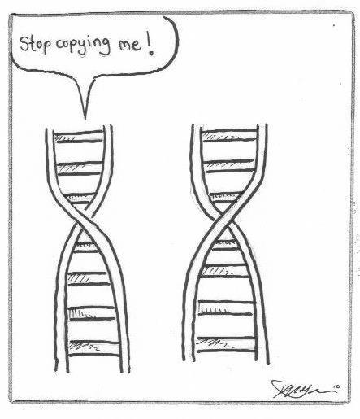
Scientific principle: replication (building an evidence base)
Replication – when a study uses the same methods as an original piece of research to see if a second (or third or fourth) study
achieves similar results. This strategy is used to build an evidence
base
Reproduction – a study that uses similar, but not the same
methods, as an original piece of research to see if similar results
can be achieved. These studies also help us to understand the
strengths and limitations of different policing strategies.

Slide 18
What is this “evidence base” of which you speak?

Slide 24
*break time*

