Slide 1
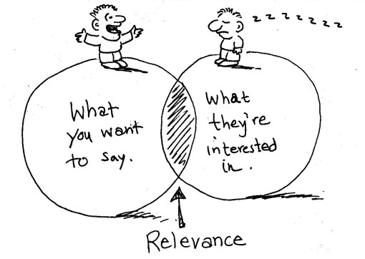
Communicating for different audiences, Part I

Slide 2
Duarte 2007

Slide 3
Talks

Slide 4
Audience: everyone Talk like Ted
https://www.ted.com/talks/julian_treasure_how_to_speak_so_that_people_want_to_listen?referrer=playlist-the_most_popular_talks_of_all

Slide 5
Audience: everyone
Assuming your audience needs and wants to be taught:
"the dominant approach to science communication risks further alienating scientists from the public by placing scientists in the role of teachers." In my experience, non-technical audiences can handle plenty of complexity, so there's no need to "dumb down" your content, nor to lecture. Scientific societies and others in the field have moved from seeking public understanding or appreciation from audiences to public engagement, a process in which the non-scientists also get to speak and share. So leave out the lecture and let them contribute.

Slide 6
Audience: everyone
Failing to answer the "so what?" question:
If you can't tell me why this matters to me, or to people to whom I can relate, you'll lose the chance to connect and really make your points. This is far more important than making sure you have covered everything you know, because it keeps your audience's needs front and center.

Slide 7
Alternative: creating a mystery
Asking the audience a ‘leading question’ and then solving the puzzle you present through your presentation:
“Why do police officers not just ‘wing’ people when they shoot?”
“Why do some communities not mind having a Hells Angels club house in their neighbourhood”?

Slide 8
Audience: everyone
Hiding behind the lectern, PowerPoint and your pointer

Slide 9
Audience: everyone
Wasting our attention at beginning or end:
Your audience attention is highest at the start and the end of your presentation--but many scientists throw it away when they insist on showing or reading a long list of acknowledgements for all the graduate students who worked on a project and the funders who supported it or other info your audience doesn’t care about.

Slide 10
Audience: everyone
Reacting, rather than responding, to questions:
When a provocative question prompts you to react, rather than respond, you lose the argument--and lose the chance to add perspective to the debate. Cultivating the ability to give a non-anxious, non-reactive answer to a wildly provocative question does take practice, a sense of humor, and some distance, but it can be done.

Slide 11
Audience: everyone
Insisting on giving your whole presentation despite the fact you’re now 15 minutes over.
Great way to infuriate audience and talk hosts!

Slide 12
Audience: everyone but especially practitioners
Insisting on using academic speak
Abstract.
From the critique of the risk’s geopolitical and its conception of “internal enemy”, we keep track of the Instruments for the New Doctrine for Hemispheric Security, making a comparative study between statements and derivative transactions of the Conference of Defense Ministers the Americas and the strategic role of the Union of South American Nations (UNASUR) in its Security Council, highlighting the disputes, breakdowns and restorations, as well as their potential, obstacles and challenges as a possible regional space in the building sovereignty and self-determination of the subcontinent.

Slide 13
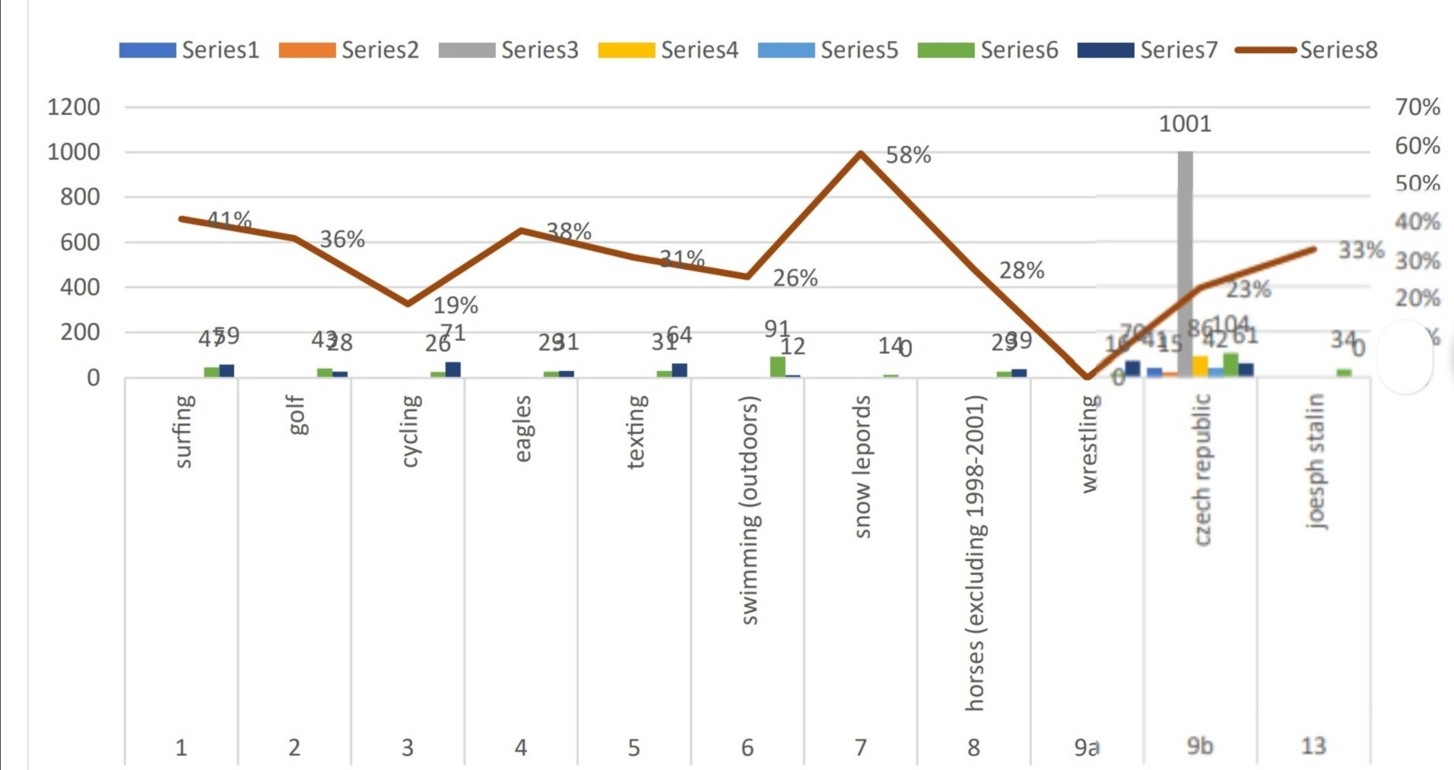
Audience: everyone
Present your data in a way that only makes sense to you and possibly 3 other people on the planet

Slide 15
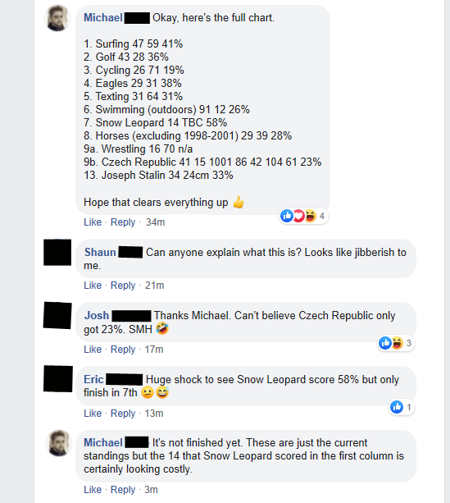

Slide 18
Audience: skeptics The ‘Sarick Effect’ (Grant)

Slide 19
Audience: skeptics The “Sarick effect” (Grant)
Leading with limitations:
Disarms your audience
Makes you look smarter (you’re willing to critically analyze things)
Makes you look more trustworthy

Slide 20
Tip: Focusing on evidence, not relevance (Ward)
Scientists too readily dive into the details of their research when speaking in public. It’s as if they are giving a lecture at a university. But in the real world, if people don’t know why the topic is important to them, they won’t pay attention, and they won’t be listening when you get around to relevance at the end of your talk.

Slide 21
Tip: Don’t lecture me (Gorman & Gorman)

Slide 22
Tip: Assuming the facts will speak for themselves: they don’t. You must advocate for the facts (Ward)
Communicating for influence is a matter of survival of the fittest. It’s not enough to deliver your information. You are competing with other voices. For example, a Louisiana biologist we worked with shared this story with us:
“I spoke in front of the metro council here in Baton Rouge... I knew the media was there, so I decided to try a quotable statement just to see if I could get one sticky enough to make the paper. There were more than 10 people who spoke in support of the ordinance, and my quote, as designed, was the only one that made it.”

Slide 23
What habits do you have that might make you a less than effective speaker?
And what can we do about them?

Slide 24
*break time*

