Slide 1
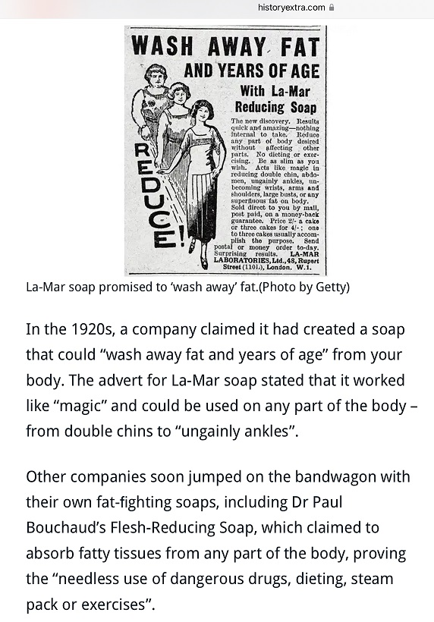
A history of some strange ideas

Slide 2
Illness

Slide 4
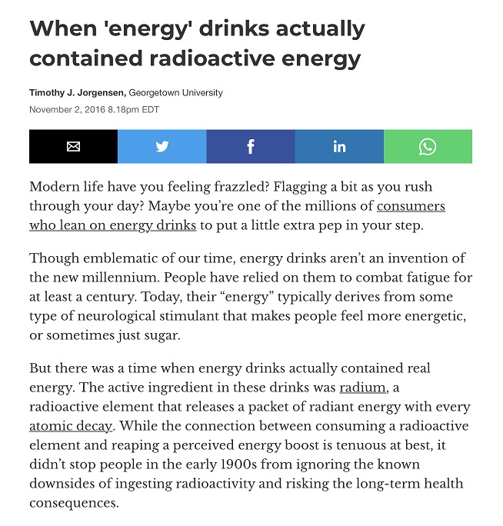

Slide 6
For Jones, magnetism was another term for hypnotherapy

Slide 8
Predicting the world

Slide 9
Your real horoscope

Slide 11
Updated version of horoscopes – fake personality tests & psychics

Slide 12
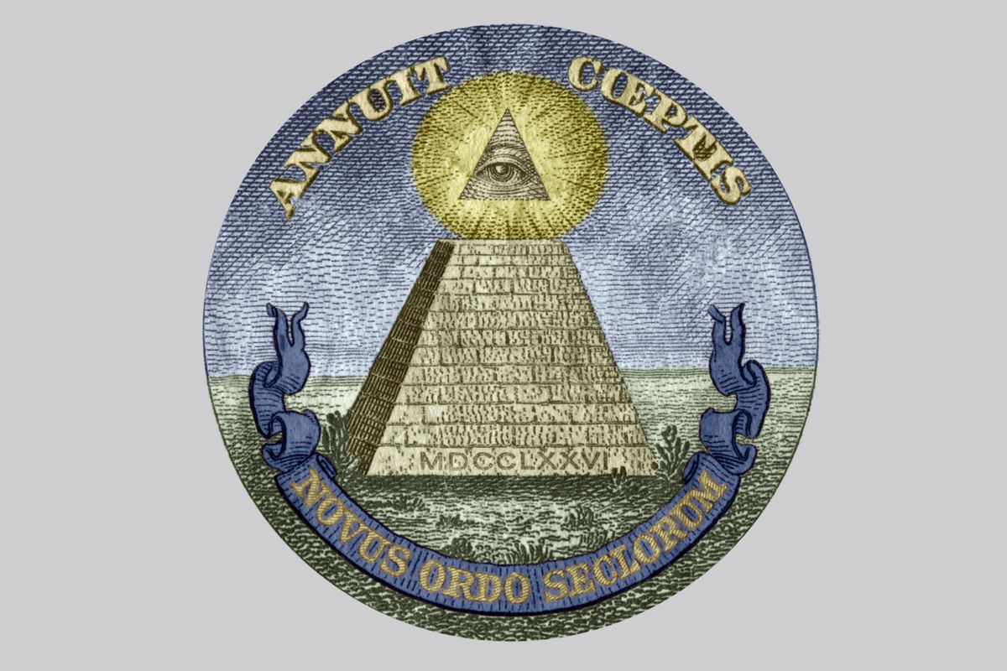
Conspiracy theories
The Illuminati, QAnon, and the Jewish conspiracy

Slide 14
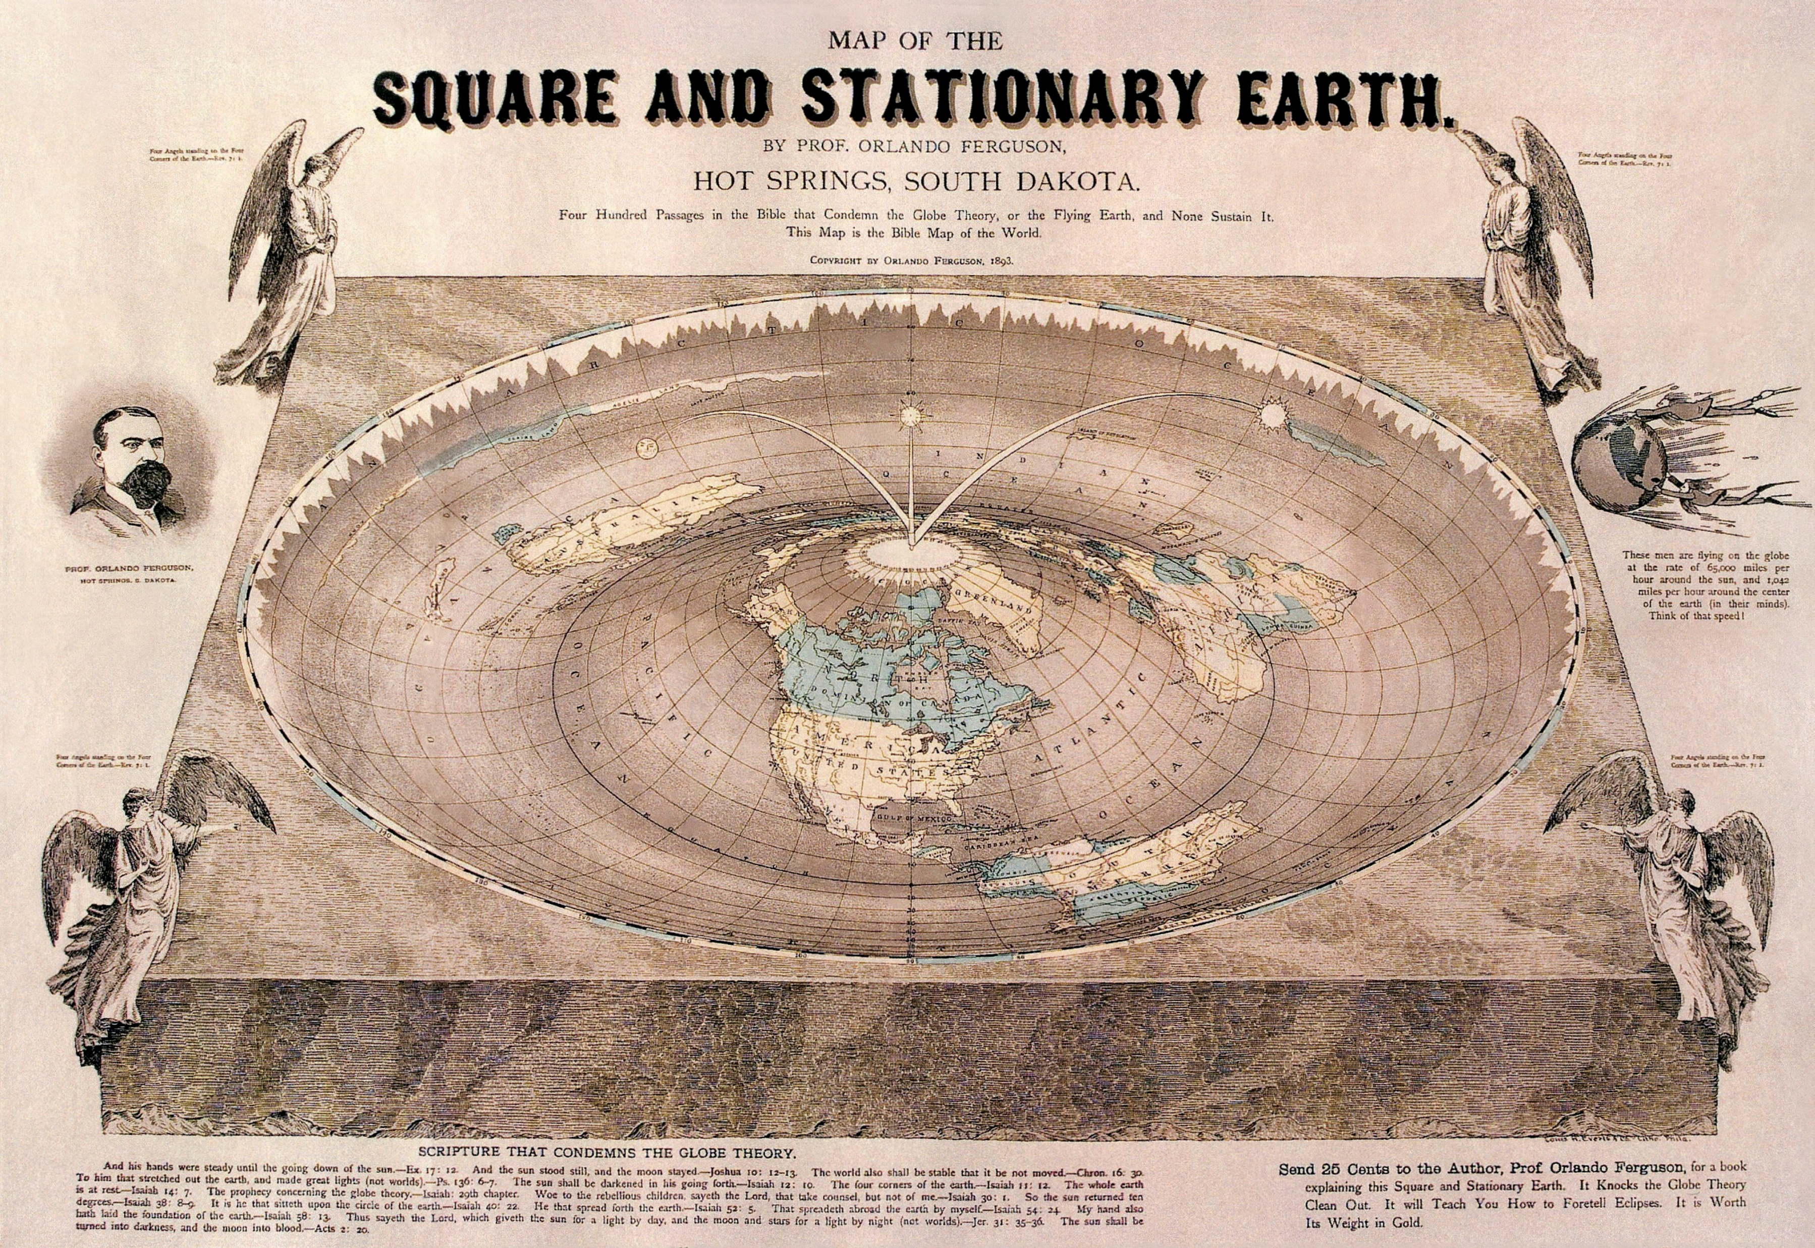
Conspiracy and related theories
The earth is flat.

Slide 15
Source: Mouallem

