Slide 1
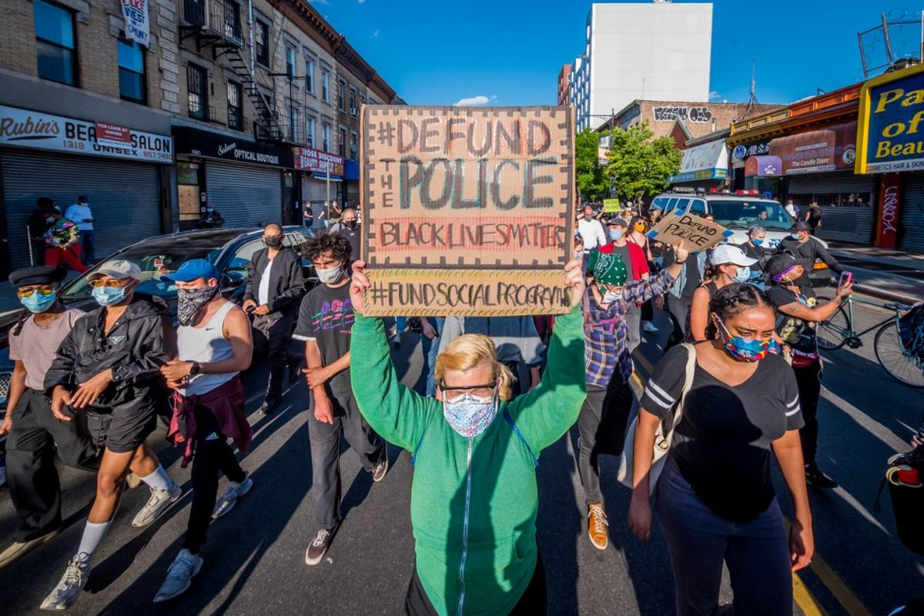
Politics of Policing

Slide 2
Abolish or Reroute Funding?
It’s not clear what the actual demand is because two different versions of this have emerged
It’s also not clear to what extent there is support for either option.
90/10 rule

Slide 3
“The Public Gets the Police It Wants”
Policing is inherently a political activity
- business complaints – visible presence/saturation policing
San Francisco
Vancouver
Edinburgh

Slide 4
What do we actually want the police to do? Bayley’s 5 solutions
David Bayley suggests a lot of the problems associated with policing actually tie into their “crime prevention” role (see Broken Windows as an example)
We expect police to prevent crime and in reality, they have very little ability to do so because crime occurs beyond their realm of control …
Five options :
dishonest law enforcement,
determined crime prevention,
honest law enforcement,
efficient law enforcement, and
stratified crime prevention.

Slide 5
Dishonest Law Enforcement (Bayley 1994)
by and large what we have now.
It occurs when the police promise to prevent crime but actually provide something else—namely, authoritative intervention and symbolic justice.
The dishonesty arises from the pretense that law enforcement in this form is an adequate solution to the problem of crime.
Dishonest law enforcement exploits the public's fear of crime. It oversells law enforcement, a fact that is known quite well by the police themselves.

Slide 6
Determined Crime Prevention
Occurs when the police dedicate themselves to taking demonstrably effective action to reduce crime.
Their attention shifts from crime to conditions and from people to circumstances. The range of their activity expands beyond the narrow bounds of law enforcement as they become publicly engaged in advocating solutions to social problems at several levels of government.
Crime is a product of complex biological and social conditions, and its prevention must involve rigorous analysis of and intervention into those conditions. This creates a profound dilemma for democratic societies

Slide 8
Honest Law Enforcement
the simplest course of action for the police in the future is to concentrate on what they are already doing well and to give up the pretense of preventing crime.
Under this option, they would provide authoritative intervention and symbolic justice, with a special focus on traffic regulation.
These functions conform to the minimalist tradition of Anglo-Saxon law enforcement. But the police would be honest about it.
They would admit also that they are not the solution to crime, that effective crime prevention requires a much broader program of action, under leadership that is not monopolized by themselves

Slide 9
Efficient Law Enforcement
If contemporary police forces cannot prevent crime because they are too busy doing other things, the obvious solution is to change their priorities.
Not only would this free resources but it would help to change an occupational culture that is preoccupied with enforcement.
EBP promotes this view

Slide 10
Stratified Policing
Decentralize responsibility for problem-solving to police at the local level, who set their own priorities for crime prevention.
POP is an example of this.

