Slide 1
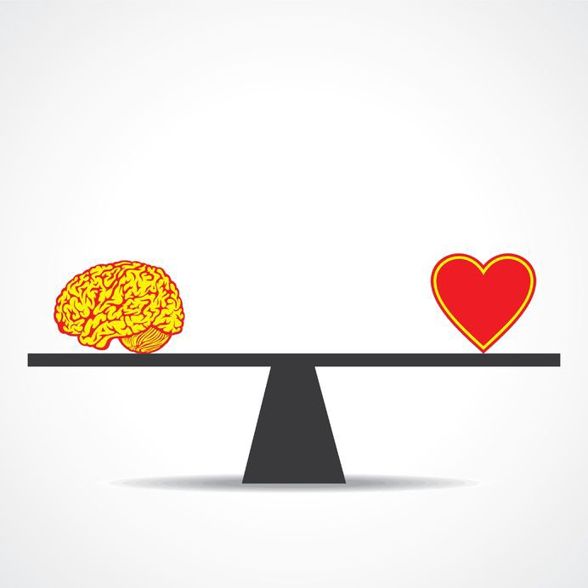
Emotions & decision-making

Slide 2
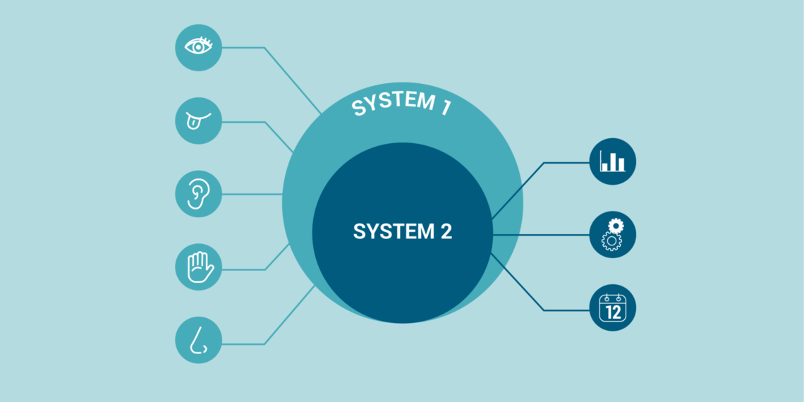
System 1 & System 2 thinking (Kahnemann & Tsversky)
System 1: near-instinctual
decisions; this is the realm of
‘every day’ thinking, unreflexive,
uncritical, gullible & susceptible
to erroneous beliefs
System 2: for higher logic; this is
where our critical thinking skills
come into play, where we can stand back and think through problems.

Slide 3
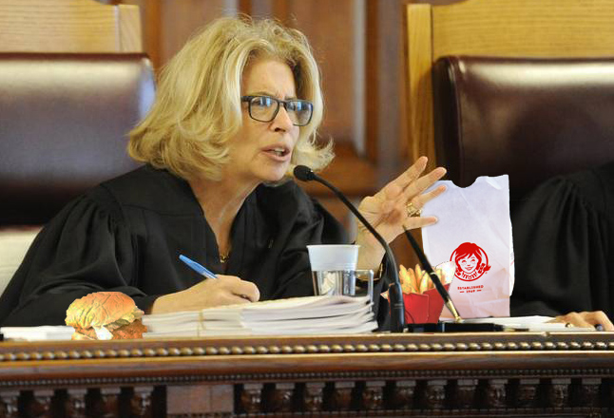
Which wins?
We make most decisions based on emotion, but even the rational parts:
  Depend on our mood (e.g. the study of judges who made more punitive decisions when they were close to lunch time (ie. “hangry”);
  Are often flawed.

Slide 4
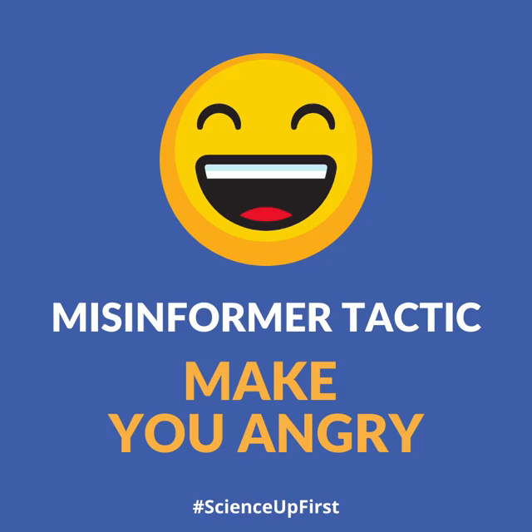
A very potent emotion: ANGER

Slide 5
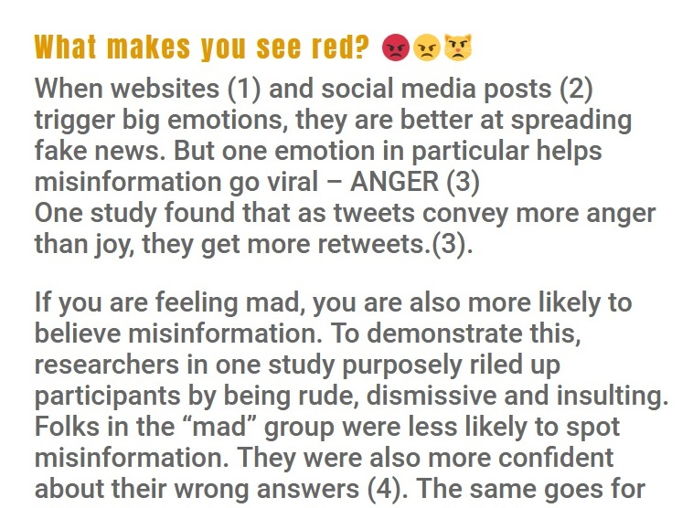
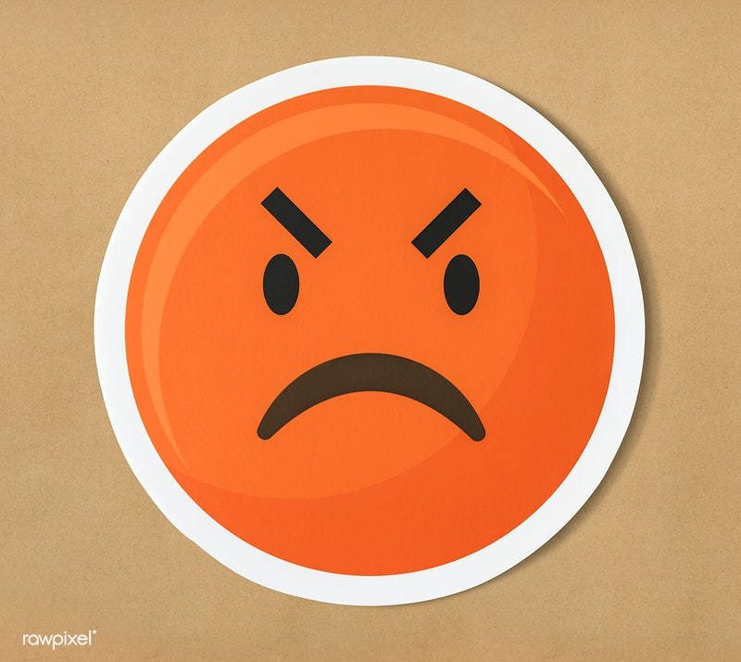
Science First:

Slide 6
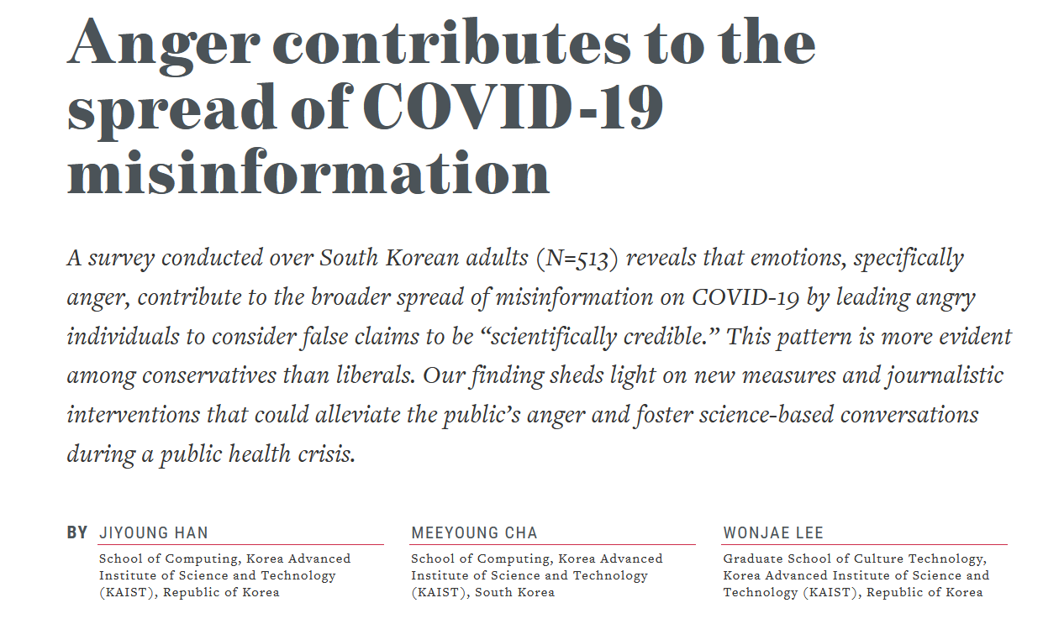

Slide 7

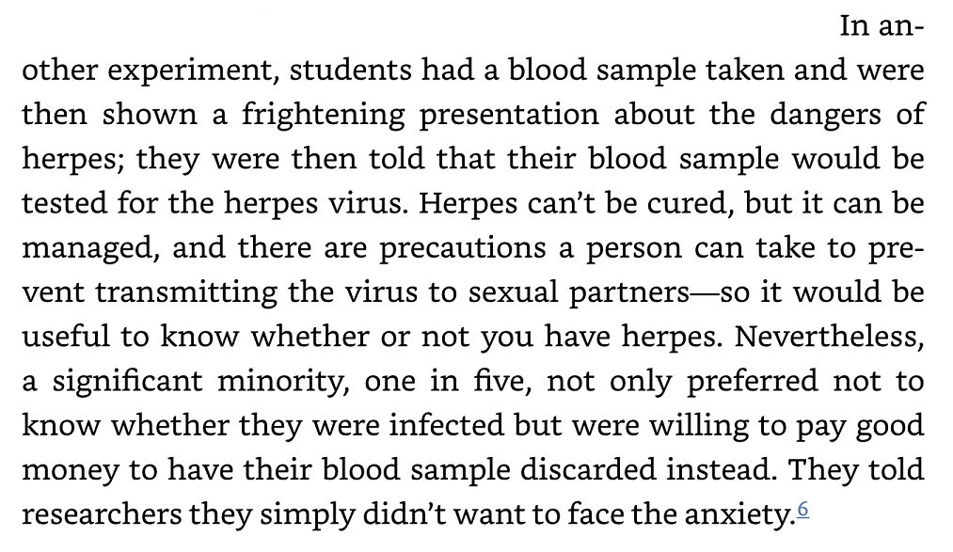
Another big one: FEAR
(Tim Harford)

Slide 8
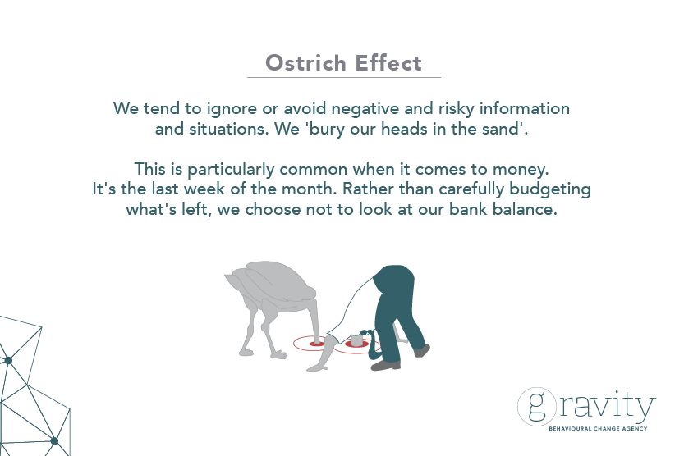

Slide 9
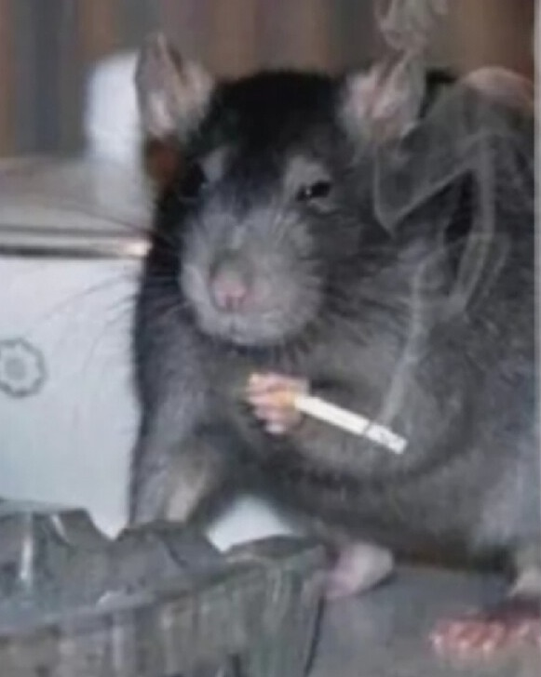
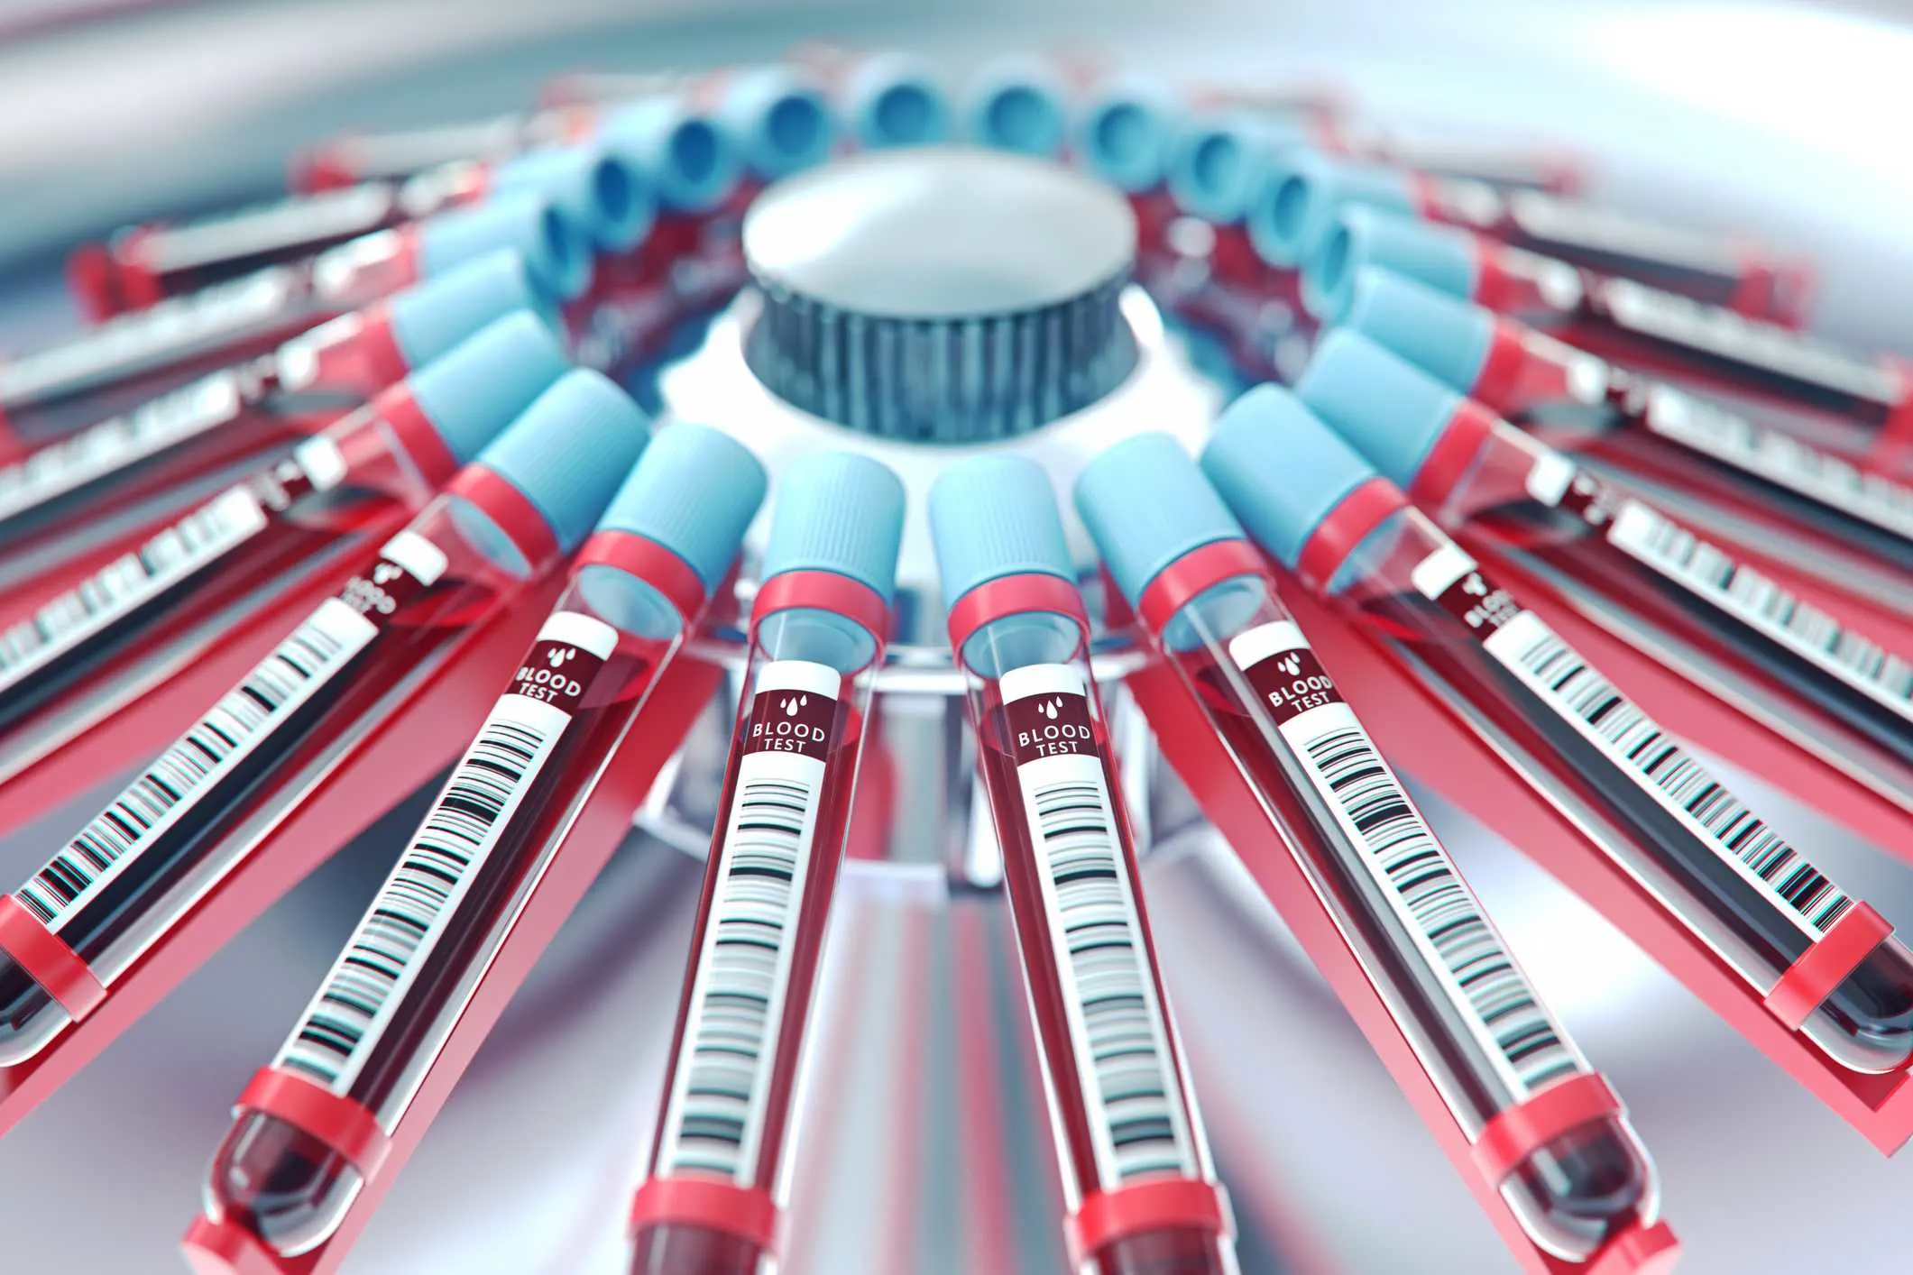
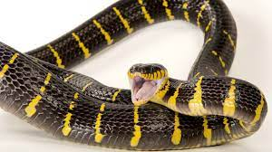
We are hardwired to have fears (Hans Rosling):
Our survival was predicated on avoiding things that could kill us like some of our most common fears:

Slide 10
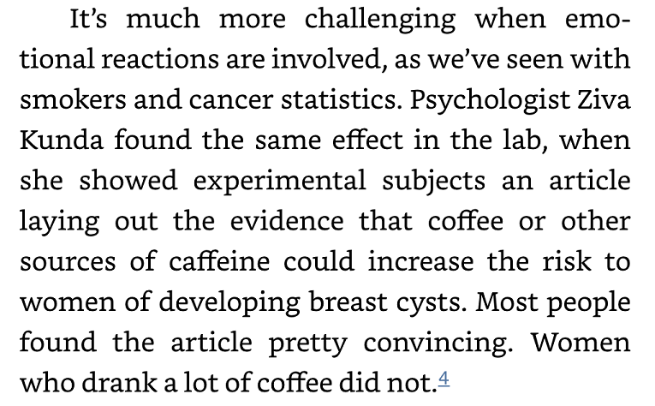
Self-interest and avoiding cognitive dissonance
(Tim Harford):

Slide 11
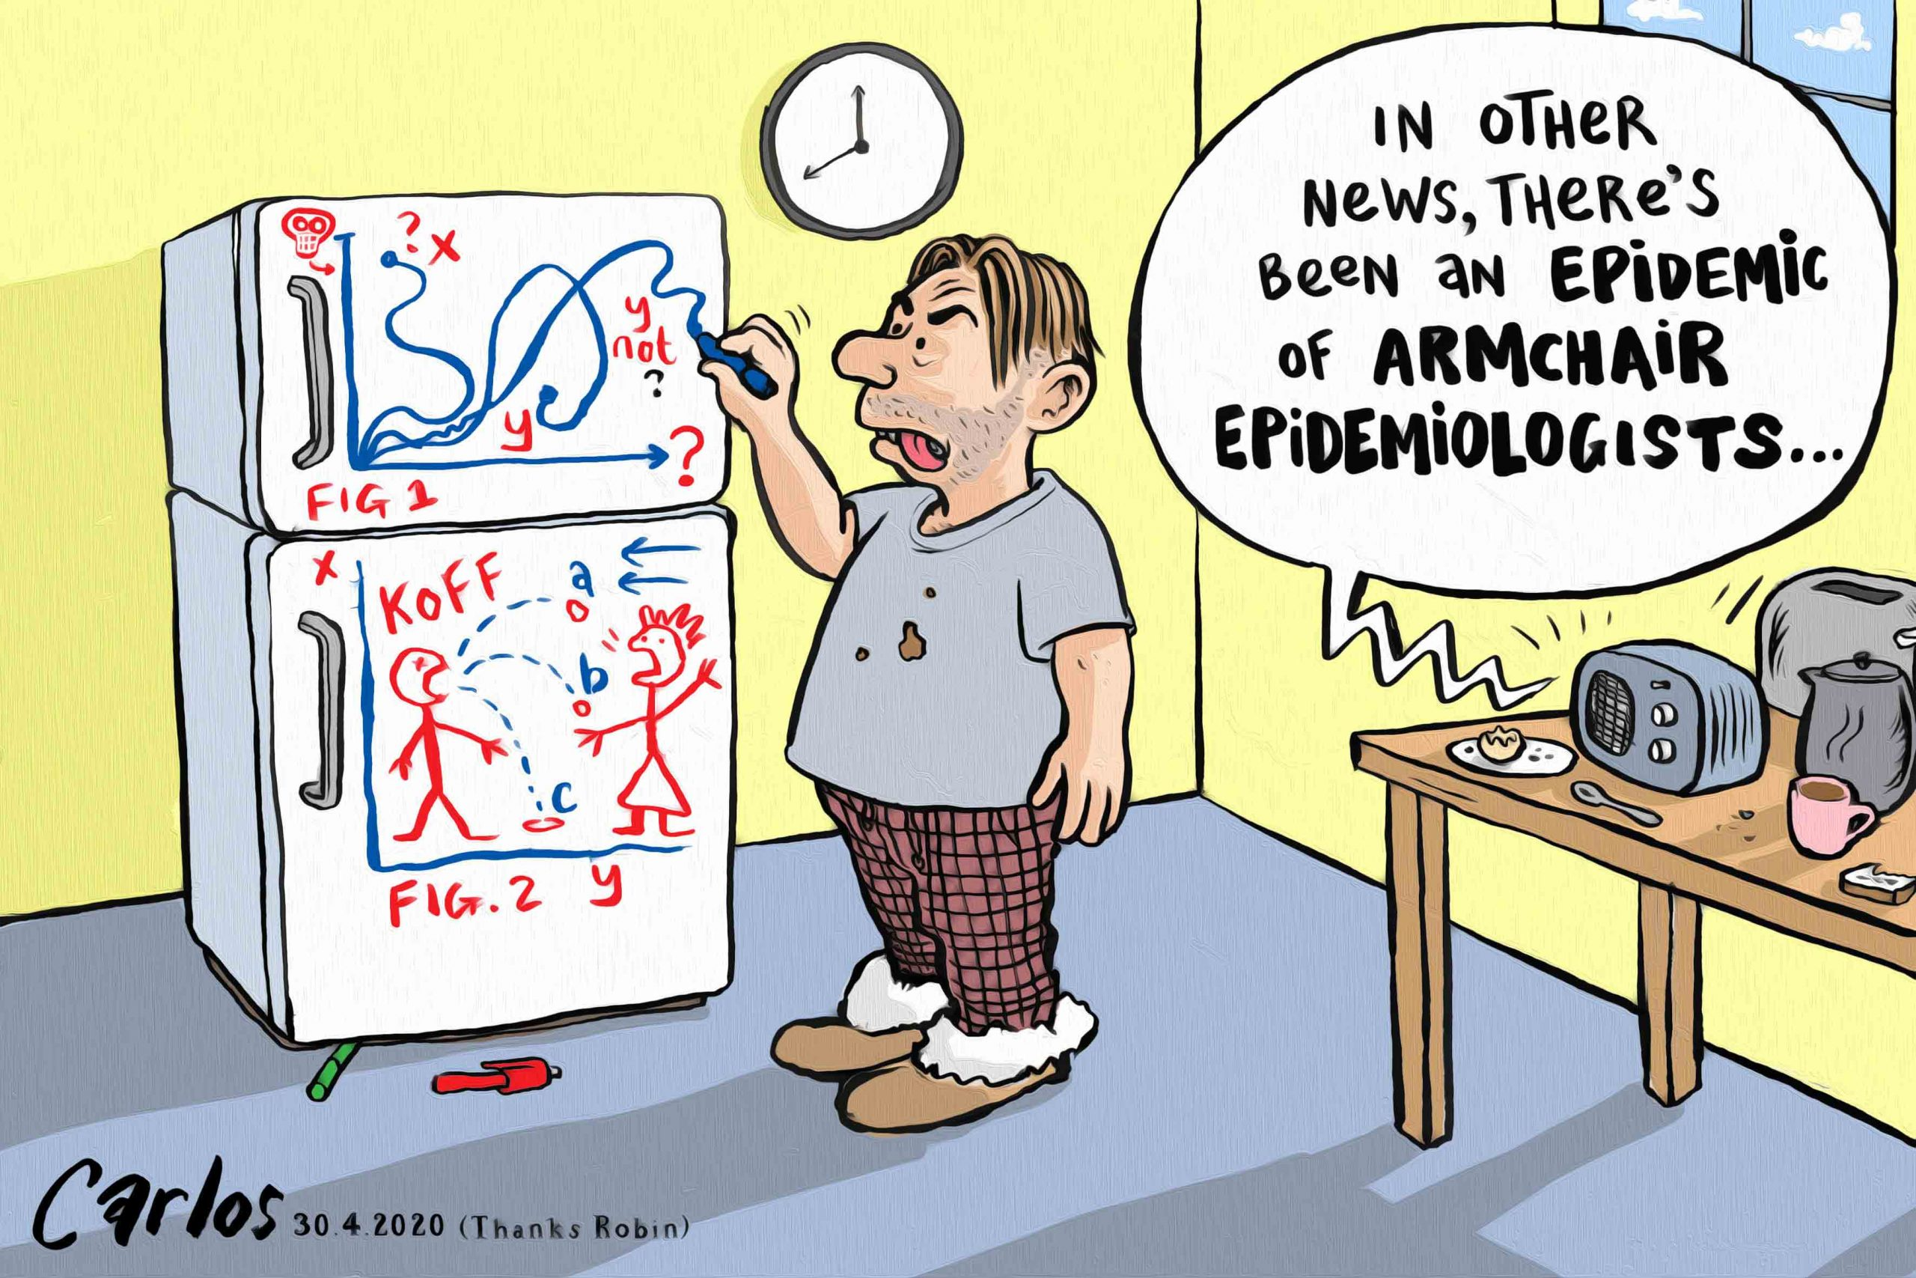
Do I really have to believe this?
To avoid having to change one’s beliefs, behaviours,
etc. we often find people looking for ‘loopholes’ in
others’ arguments.
Intuitively we think that more facts and data can
sway people to change their minds, but …
the more facts and figures, often the more opportunities people have to find ‘loopholes’ to discount the information!!

Slide 12
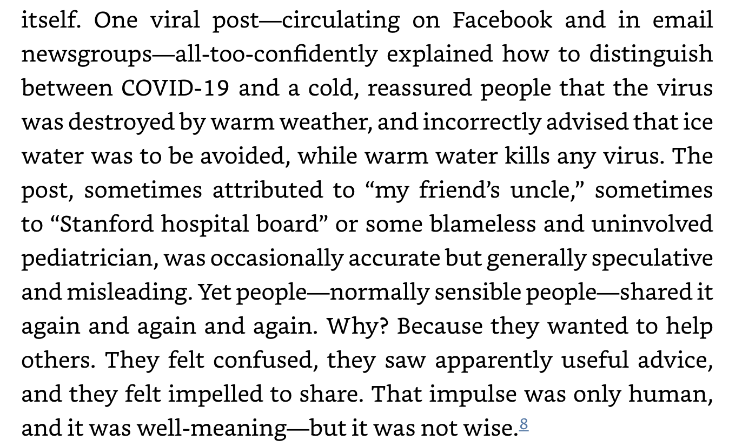
Altruism (helpfulness) (Tim Harford):

Slide 13
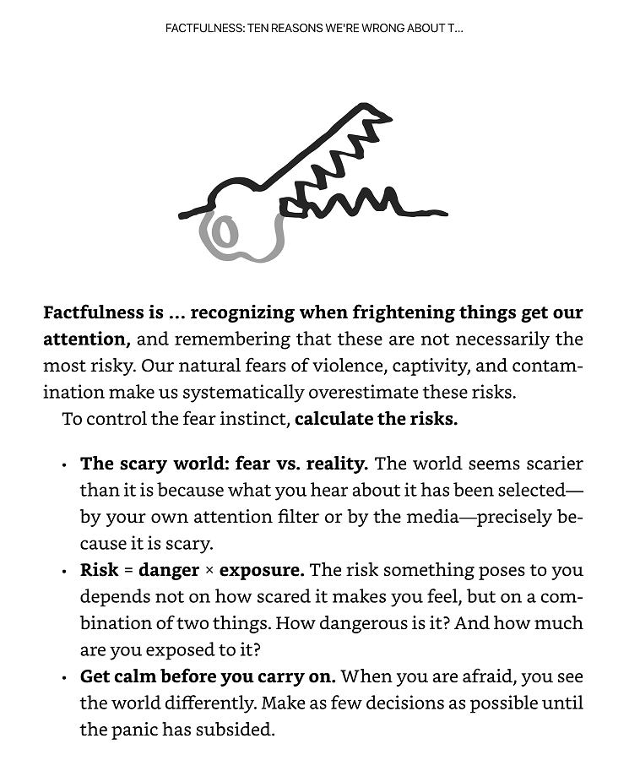
Hans Rosling on managing emotional decision-making

Slide 14
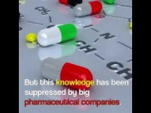

Slide 15


