Slide 1
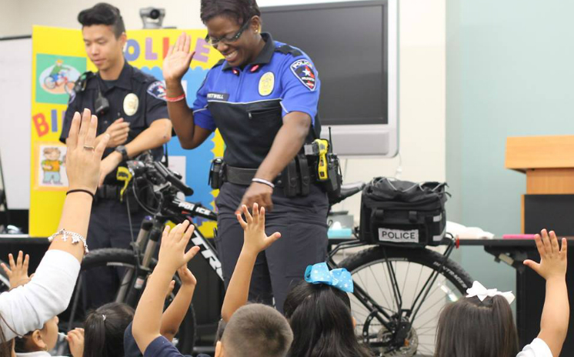
Community policing

Slide 2
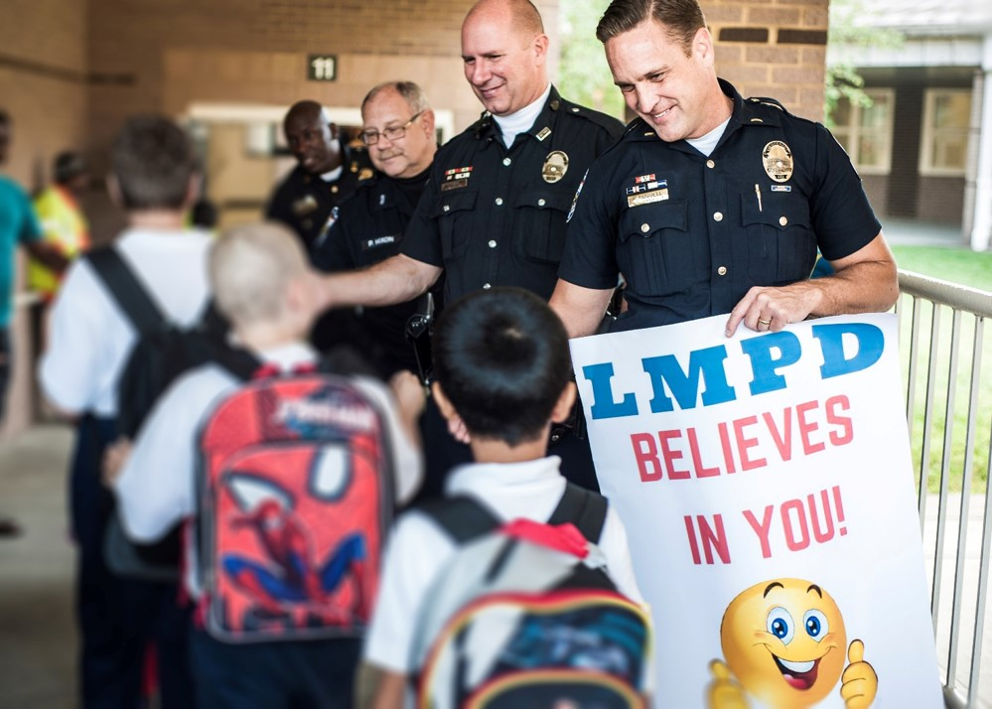
Basic definition:
The process of enabling the participation of citizens and communities in policing at their chosen level, ranging from providing information and reassurance, to empowering them to identify and implement solutions to local problems and influence strategic priorities and decisions (NPIA 2012).

Slide 3
Supposed benefits:
Reducing crime – Weak positive evidence: some positive findings, some neutral, no negative.
Reducing disorder and anti-social behaviour – Fairly strong positive evidence: mostly positive findings, some neutral, no negative.
Increasing feelings of safety – Fairly strong positive evidence: mostly positive findings, some neutral, no negative.
Improving police community relations and community perceptions –Strong positive evidence – almost all positive findings, minimal neutral, no negative.
Increasing community capacity – Unknown: this is a gap in the evidence
Changing police officers’ attitudes and behaviour – Fairly strong positive evidence on attitudes; mixed evidence on behaviour.

Slide 4
Objectives
Systematically review and synthesize the existing research on community-oriented policing to identify its effects on crime, disorder, fear, citizen satisfaction, and police legitimacy.
Methods
We identified 25 reports containing 65 independent tests of community-oriented policing, most of which were conducted in neighborhoods in the United States. Thirty-seven of these comparisons were included in a meta-analysis.
Results
Our findings suggest that community-oriented policing strategies have positive effects on citizen satisfaction, perceptions of disorder, and police legitimacy, but limited effects on crime and fear of crime.
Conclusions
Our review provides important evidence for the benefits of community policing for improving perceptions of the police, although our findings overall are ambiguous.

Slide 6
RCMP IMIM model

Slide 7
Community policing ‘old school’ style

Slide 8
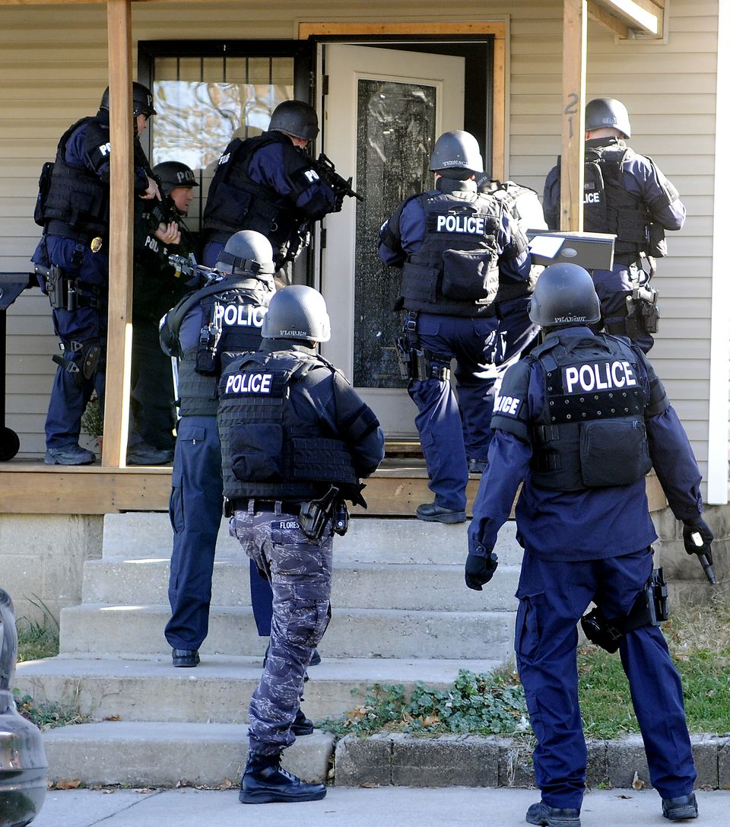
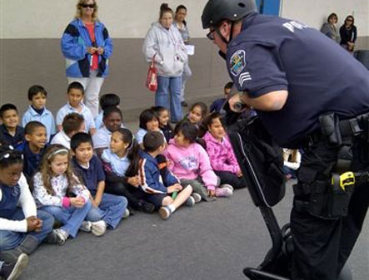
Police officers are invested in the status quo (want to see themselves as macho hardchargers) and do not value community input, and they are not typically rewarded for CP-related tasks and duties, whereas producing ‘good arrests’ is rewarded.

Slide 9
What do many cops really think of community policing?

Slide 10
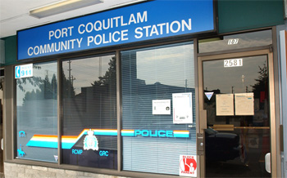
Police organizations don’t want to expend resources on programs that they see as ineffective and costly
“[community policing is] an
example of a desire for a
Mercedes-type service on a
VW-type budget.”
Do YOU want to pay higher taxes to fund this?

Slide 11
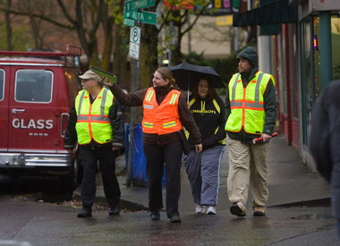
Lack of community buy-in/volunteer fatigue

Slide 12
Community policing programs: Neighbourhood Watch

Slide 13
*break time*

