Slide 1
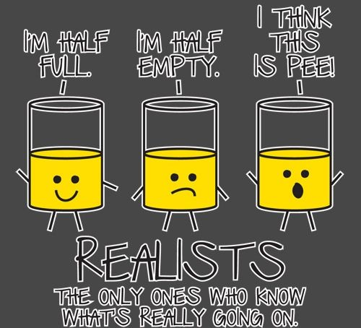
The Realist Approach to EBP

Slide 2
How can we say ‘what works’?
EBP has been near-exclusively focused on the question of ‘what works’
This is a great starting point; however, research is needed to also help us better understand the causal mechanisms and contexts that can drive successful interventions or kill great program ideas.
The ‘realist approach’, most notably associated with Ray Pawson and Nick Tilley is a critique of the naive view that all we need to do is focus on outcomes (or worse, outputs).
Ie. Program X worked in Cincinnati, so it will work in London, ON (also known as ‘naieve policy transfer.’

Slide 3
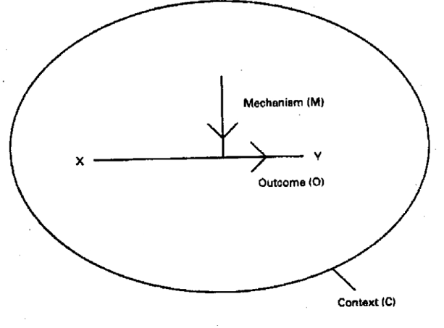
The question of how things ‘work’ needs to be focused on (Pawson 1995):
patterns – that is, the total evidence base – what worked, what didn’t work, what was somewhat successful and WHY
To understand patterns we need to also consider mechanisms and context

Slide 4
Mechanisms
Mechanisms are the key elements that generate the change desired
E.g. I drink coffee, I get more productive. The mechanism? Caffeine

Slide 5
Contexts
All social interventions operate within social, political, economic and other spheres … or contexts.
Contexts can include the resources AND the limitations/roadblocks that might limit the success of an intervention.

Slide 6
4 Contextual Layers (4Is) – Pawson 2006
Infra-structural system – does the intervention have the political backing? The public support? The resources to ensure its goals?
Institutional setting – does the institutional culture of the organization/institutional support such an initiative?
Interpersonal relationships – are there strong relationships/trust/respect between key personnel and supporting staff that would increase successful adoption of an intervention?
Individual capacities – do key actors have the motivation, skills, credibility, and drive to move an intervention forward?

Slide 7
Anyone who is interested in influence public policy is necessarily arguing for a form of social intervention.
A social intervention is, simply,
a strategy intended to change a social condition (usually for the better).
E.g. reducing the risks of smoking; prisoner re-entry programs; recreational planning for elderly citizens.

Slide 8
How to understand an intervention – 7 elements (Pawson 1995)
Interventions are theories – causal explanation for how things work or could work
Interventions are active – you are acting on and through people (which can be fraught with problems)
Intervention chains are long and thickly populated – many people can be involved in the development, refinement and/or revision of an intervention – from program creators to community partners to other agencies, and so on.

Slide 9
Intervention chains are non-linear and sometimes go into reverse – they can be both top-down and bottom-up or any combination thereof.
Interventions are embedded in multiple social systems – take the examples of smoking prevention programs or elderly rec programming, these types of initiatives can cross also sorts of institutional and other boundaries. Most social interventions deal with very complex issues that are inter-connected.
Interventions are leaky and prone to be borrowed – programs and practices can be modified ‘on the ground’, borrowed and changed at will. E.g. hot spot policing.

Slide 10
Interventions are open systems and change the conditions that make them work in the first place – sometimes this is good (that’s the aim), but other times an intervention can have unintended (negative) consequences.
E.g. CCTV cameras – displacement effects, people ignoring them
E.g. Officer Scarecrow – people realizing it’s fake and stealing the sign

Slide 11

*break time*

