Slide 1
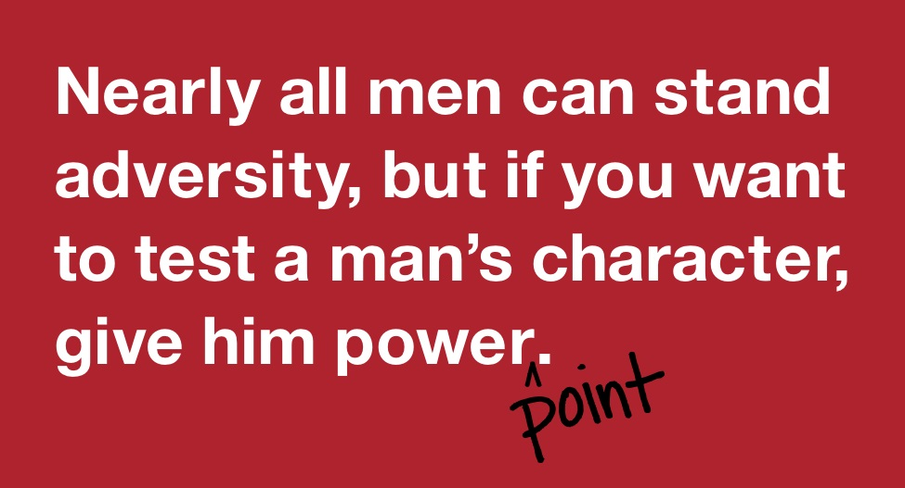
Presentations
Duarte 2008

Slide 2
5 principles to present your data in a way that is accessible for audiences (Duarte 2007)

Slide 3
Duarte (2007)

Slide 4
The ‘Wall of Text’ (aka ‘docuslide’)

Slide 5
Reducing text (Duarte 2007)

Slide 6
#CrimComm countries represented
• Canada
• Australia
• Belgium
• Bolivia
• Bosnia and Herzegovina
• Brazil
• Chile
• Colombia
• Denmark
• Ecuador
• Finland
• France
• Germany
• Greece
• India
• Indonesia
• Ireland
• Italy
• Kenya

Slide 7
#CrimComm countries represented

Slide 8
You can also go over-board with too many visual elements

Slide 9
Components of a great slideshow (Duarte 2008)

Slide 10
Backgrounds

Slide 11
Be thoughtful about your background

Slide 12
Colourful (and great use of text and imagery)

Slide 13
Using colour & text to highlight key points

Slide 14
Timing can be an issue

Slide 15
Some (unfortunately) unsuccessful design prototypes!
Ya can’t win them all!

Slide 16
Posters

Slide 19
*break time*

