Slide 1
Biases

Slide 2
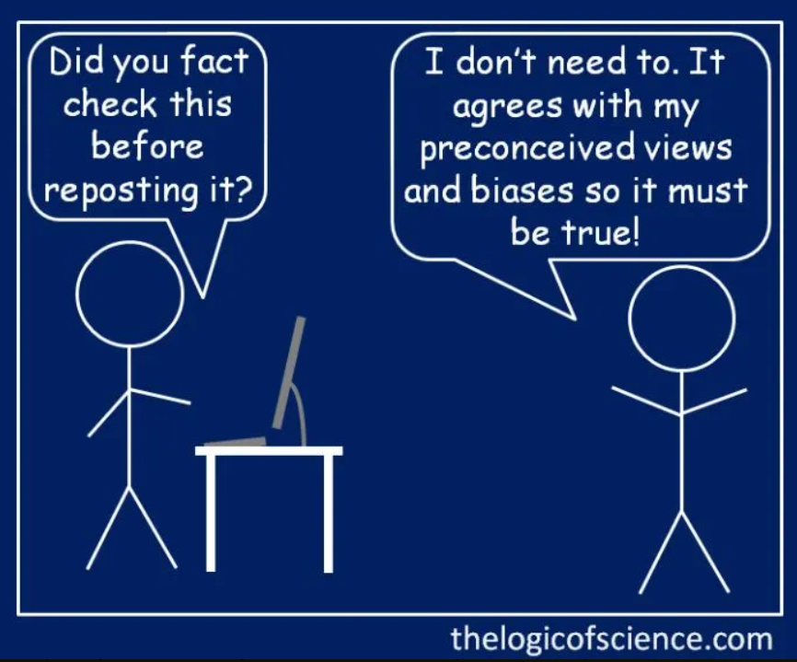
What is a cognitive bias?
It’s a systematic error in judgment that humans make because our brains our wired to take mental ‘short cuts’ (it’s easier and thus more efficient for us … although it can lead to some poor outcomes!)
There are over 50 of these biases that have been identified
Relax: we’re only focusing only on those most relevant to helping you protect yourself against misinformation

Slide 3
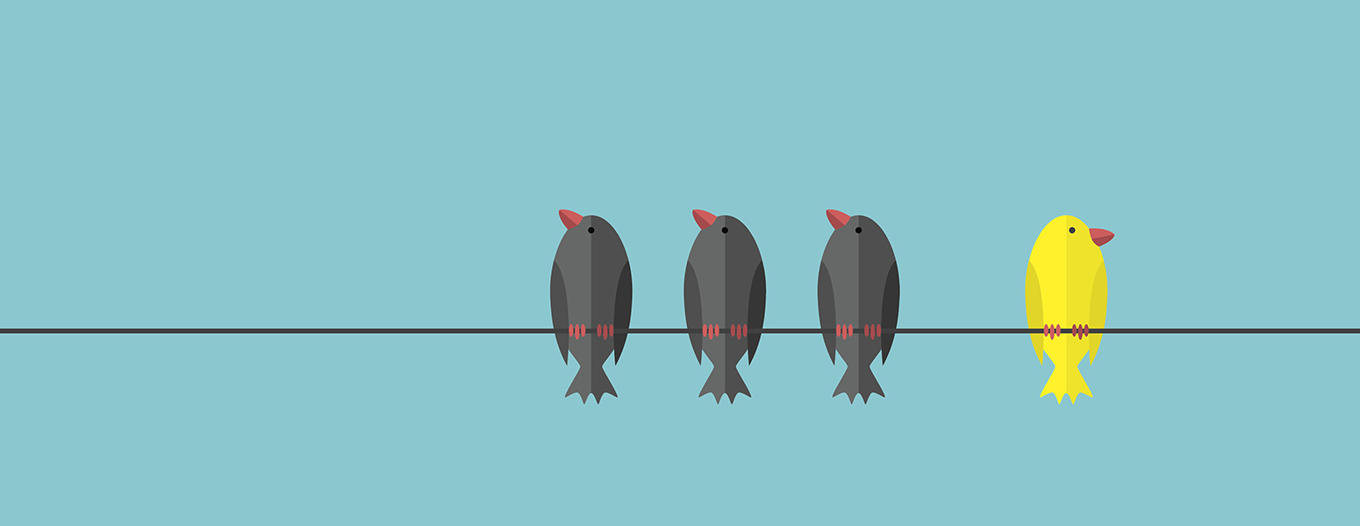
Blind spot bias
Humans have a marvellous ability to see ourselves as bias-free and everyone else as biased. I have some bad news for you ….

Slide 4
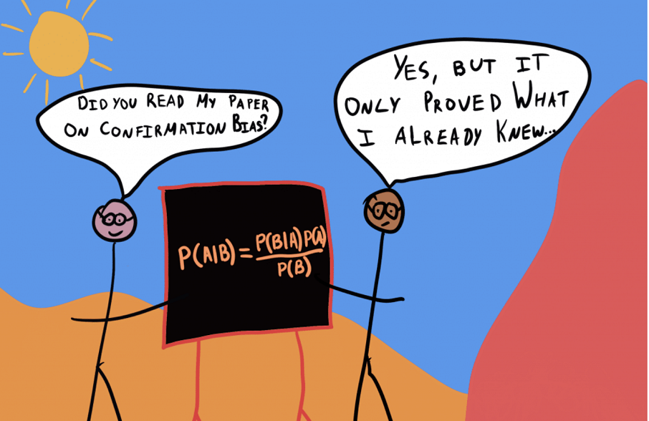
Confirmation Bias
Humans suffer from selective attention. We tend to focus on things that fit our already existing ideas and beliefs
When challenged, we also tend to search for “facts” that support our views, interpret them accordingly (conveniently discounting contradictory information)
Decision Lab

Slide 5
Confirmation bias

Slide 6
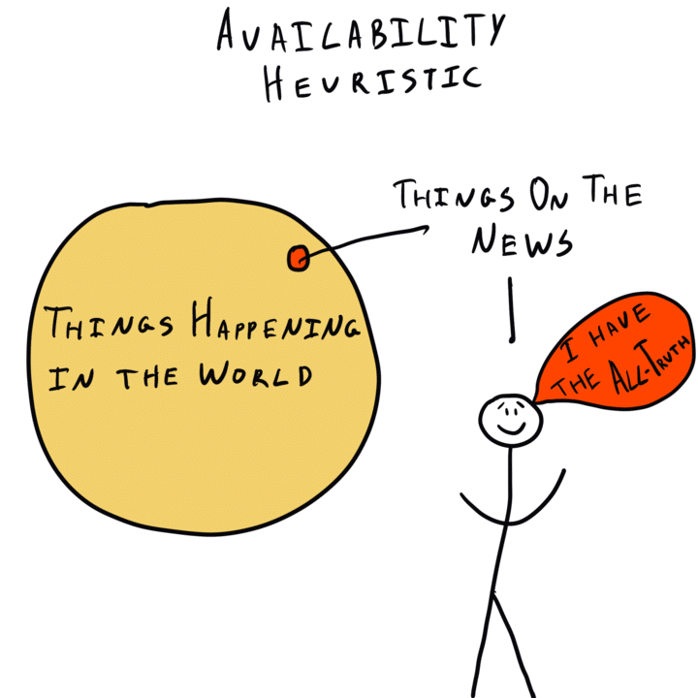
Availability heuristic/cascade
Availability heuristic: information that is recent is easier to recall, thus we often think it happens more frequently than it does. E.g. gun crime, plane crashes
Availability cascade (aka Illlusory Truth Effect): the more an idea gets repeated in public discussions, the more reinforced/entrenched that idea becomes – essentially, it takes on a life of its own!
Decision Lab

Slide 7
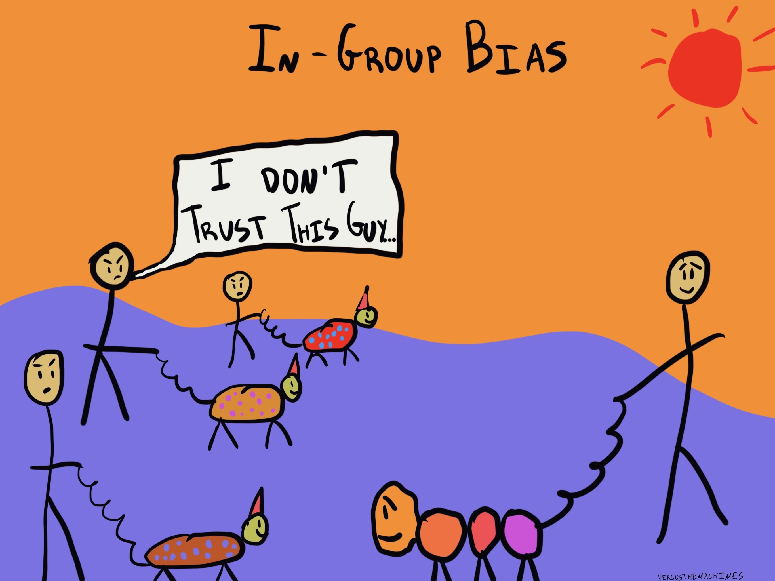
In-group bias (our tribal minds)
We see ourselves as belonging to particular groups – might be on the basis of gender, race, politics, religions, etc. – and to give members of “our group” preferential treatment.
What do I mean? We’re more willing to believe our group members, to avoid challenging them, to see them as having “strong values” and “good beliefs”
We are not as kind to groups to which
we don’t see ourselves as belonging
Decision Lab

Slide 8
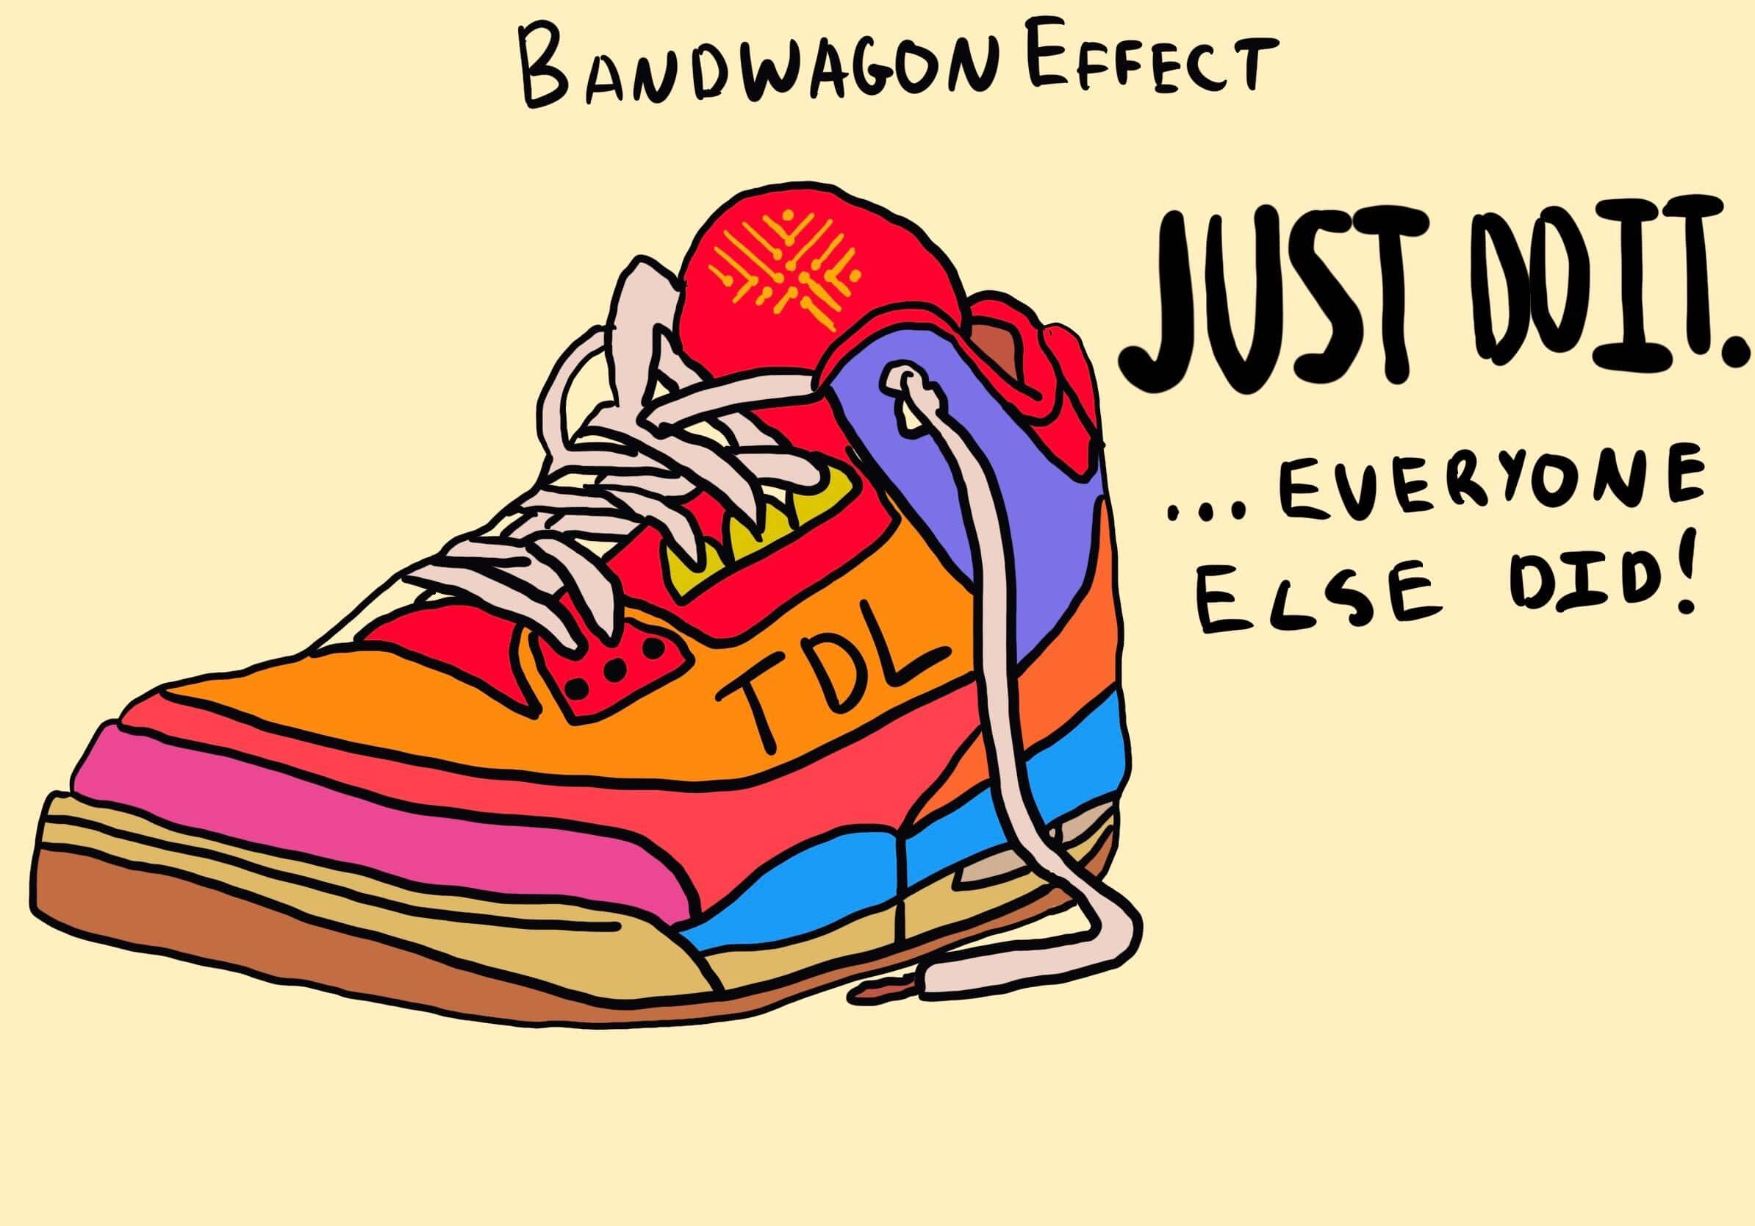
Bandwagon effect
Decision Lab
Related to the availability cascade, it’s the tendency to believe something because other people you identify with also believe it.
It’s also related to our tendency to see ourselves as part of ‘in-groups’ and set ourselves up against ‘out-groups’ (us versus them).
Celebrity and popular culture can also play a major role in creating bandwagons.

Slide 9
Backfire effect
Ever felt the urge on social media to just start cyber-shouting about how wrong someone is with lots of facts & data? Chances are the end result will be the person further entrenches their position. The backfire effect is when you influence someone into continuing to hold their view rather than getting them to change their mind.
This is why Twitter fights are usually a complete waste of time

Slide 10
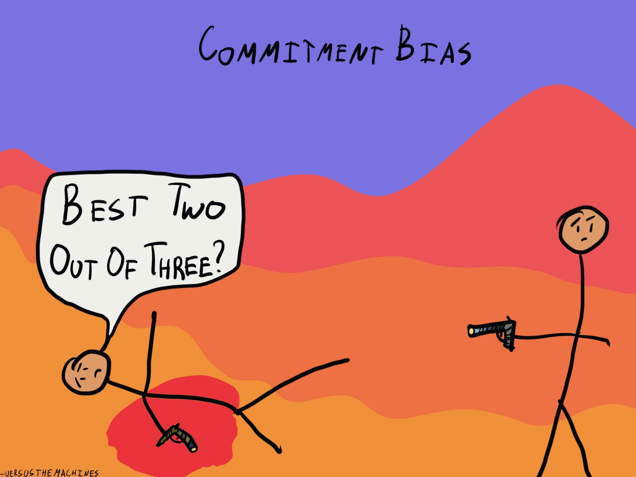
Commitment bias
Once we “learn” something, it can be difficult to “unlearn it”, even when new information reveals it to be false.
Another term I use for this is the “doubling down” effect. If someone has committed – especially publicly – to a belief or behaviour, it can be very difficult to say, “oops … I was wrong.” Usually, the belief persists. Reason 87 not to argue on the Internet.
Decision Lab

Slide 11
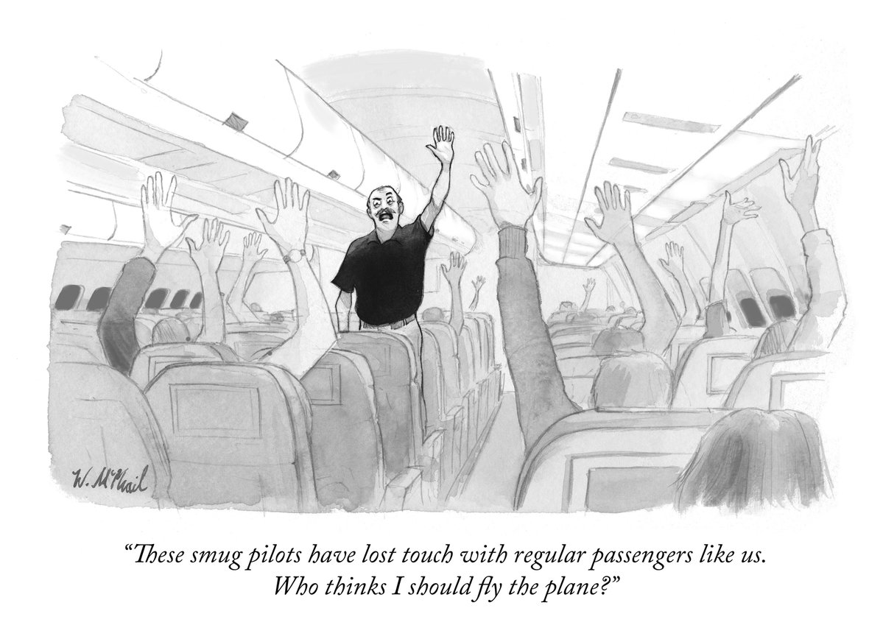
Dunning-Kruger effect
A real expert is someone who is keenly aware of how little they know in a given area because they actually know the research landscape.
A non-expert is someone who does not actually know the field and somehow manages to completely overestimate their knowledge and skills (also known as ‘Monday Morning quarterbacking’).

Slide 12
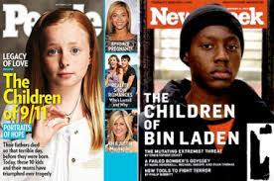
Framing effect
How ideas or decisions are presented to us can greatly influence how we perceive things and the choices we make.
Media headlines are a perfect example of this.

