Slide 1
Street checks

Slide 2
Street check
A pedestrian stop during which a police officer asks an individual for information for the purpose of pursuing an investigation into criminal activity.
Also known as ‘carding’ – in Canada
And as a ‘Terry stop’ or SQF in the US (stop, question and frisk) and stop and search in the UK

Slide 3
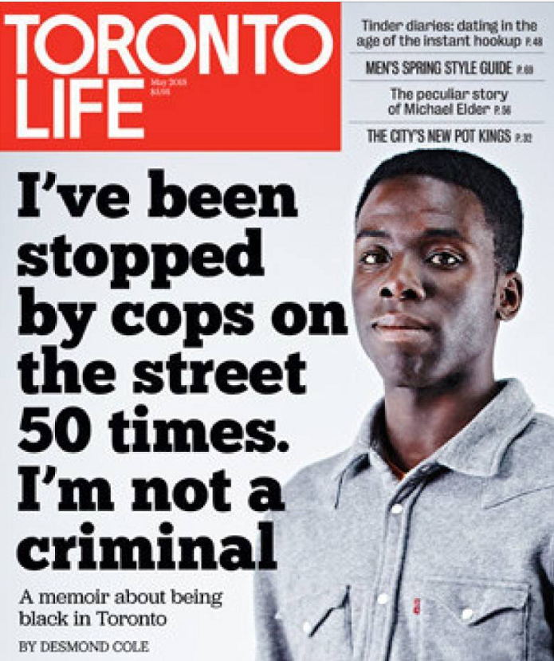
Arguments against street checks
Minority populations (particularly black males) are disproportionately targeted as potential suspects

Slide 4
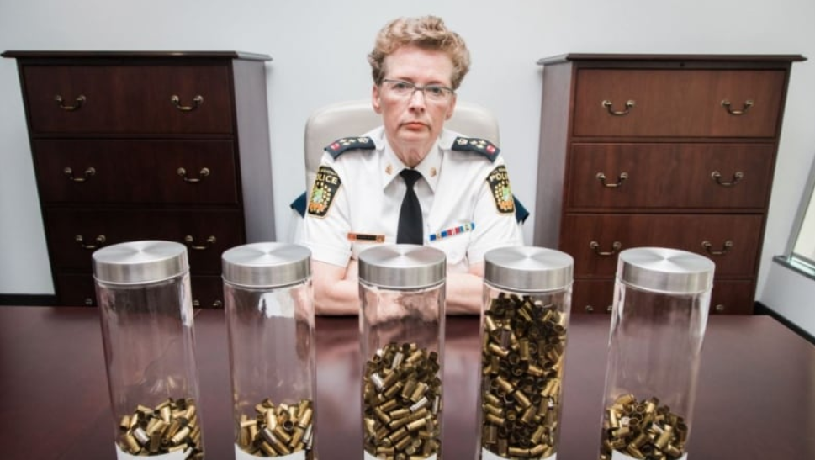
Arguments for street checks
Functions as a crime deterrent
Investigative tool useful for solving major crimes

Slide 5
Ontario Ministry regulation in effect since January 2018

