Slide 1
Dealing with the tough stuff

Slide 2
Difference as a threat to identity

Slide 3
Shapiro on Negotiating the Nonnegotiable:
“When our identity feels threatened, we tend to react with a rigid set of behaviours that neuroscientists call a threat response.”
This threat plays into what sociologists call our in-group/out-group status or, as Shapiro puts it, our “Tribes Effect.” With the Tribes Effect, minor differences can lead to feelings of threat.

Slide 4
5 Lures of the tribal mind
vertigo
repetition compulsion
taboos
assault on the sacred
identity politics

Slide 5
The Five Pillars of Identity (Daniel Shapiro)
Beliefs – refer to specific ideas you hold as true
Rituals – personally meaningful customs and ceremonial acts, such as holidays, rites of passage, family dinner, prayer
Allegiances – loyalty ties to an individual or group
Values – guiding principles and overarching ideas, such as justice, compassion, freedom.
Emotionally meaningful experiences – intense positive or negative events that define a part of you – could be the day your first child was born or a memory of violence against you or your group.

Slide 6
Let’s look at some examples and see which of the 5 we can relate these comments into.

Slide 13
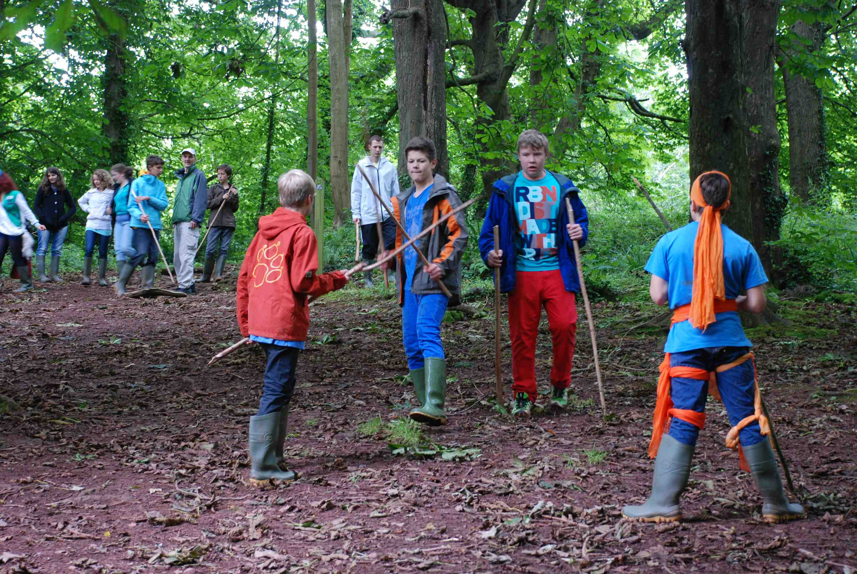
Tribes effect
adversarial
self-righteous
closed mind

Slide 14
Advocacy trap - Conner
People don’t start out as enemies – it happens in stages.
When people disagree with us, we first question their views, but eventually we question their motives and intentions. When they persist in their disagreement with us, we perceive them as aggressor (from Hoggan).

Slide 15
Discussion: how can we avoid falling into the advocacy trap?

Slide 16
*break time*

