Slide 1
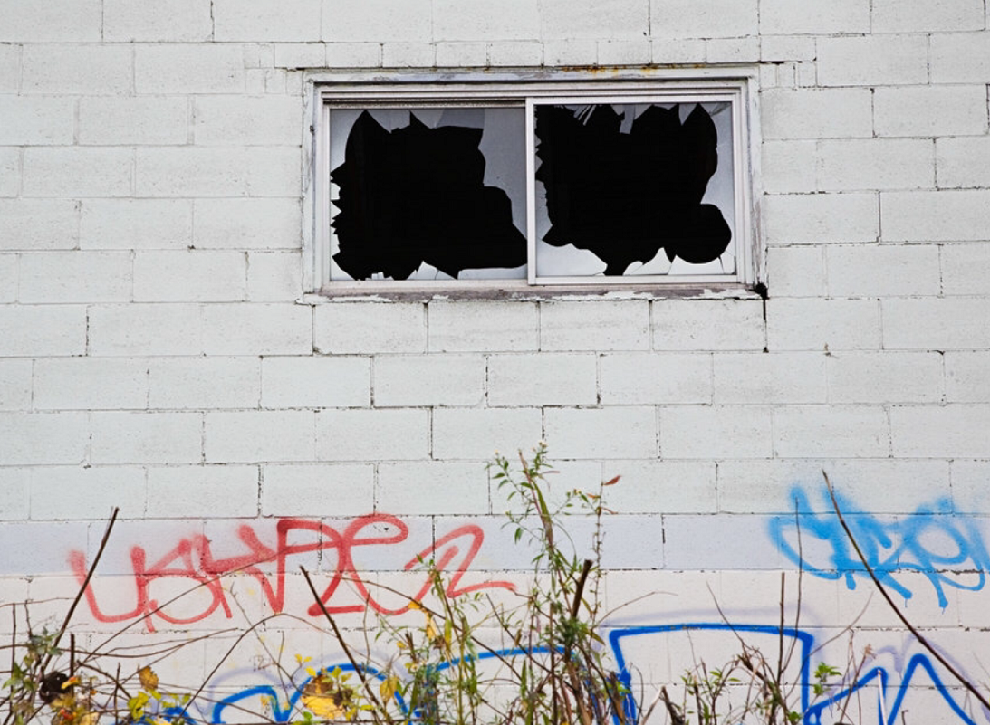
Broken Windows (Wilson & Kelling 1982)

Slide 2
Broken Windows core ideas:
Based on aspects of environmental criminology (including some of what has been called routine activities theory):
Crime or lack of crime is based on:
Conformity to social norms (whether good or bad)
The presence or absence of guardians who monitor a space
Social signaling and/or signal crimes (crimes that signal space is unguarded).

Slide 3
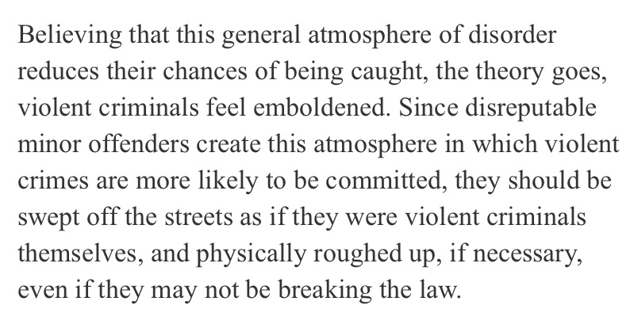
BW as practiced in New York

Slide 4
BW came to equal ZT
A ‘get tough on crime approach’ emphasizing strict non-discretionary law enforcement
Best example:
Crackdown policing
- Wilson and Kelling came out and said BW and ZT should NOT be treated as the same and there should be safeguards in place to ensure they are not conflated … however …

Slide 5
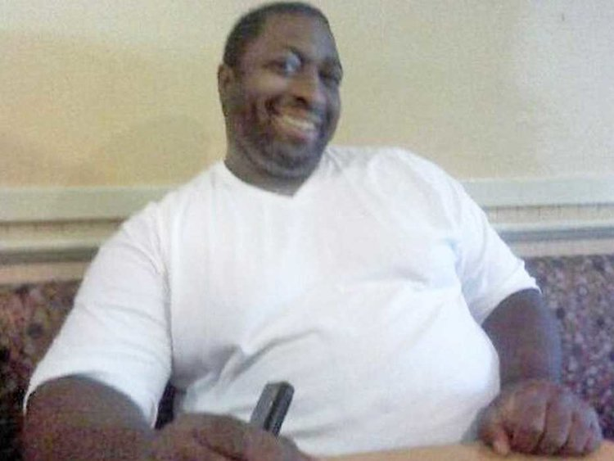
Eric Garner (d. 2014)

Slide 6
https://www.youtube.com/watch?v=OWoZ4Mj9028

Slide 7
The Use of Chokeholds in Canada
A police officer fighting an unarmed resistor in a deteriorating situation may be tempted to use incapacitation holds to take someone down.
One method is the chokehold which involves the officer placing his arm against the windpipe of the subject from behind and pressing to cut off air to the lungs. The chokehold was banned by the RCMP for its members in 1979 and by other police services about the same time, as it was too dangerous.
Too often a chokehold inexpertly applied resulted in serious injury or death. Similarly, the carotid control technique involves an officer from behind using his arms to cut back the flow of blood to the brain and inducing unconsciousness. This is permitted to RCMP members only when their lives or the lives of others are at stake (Beahan 2008)

Slide 8
Group activity
Is there any way to engage in Broken Windows style policing that focuses on preventing signs of disorder but doesn’t target people?
How would you do it? Given some examples?
If not, then how do you think police should be focusing their attention in order to deter crime? (feel free to draw on what you’ve learned about random patrol, rapid response, reactive investigation).

