Slide 1
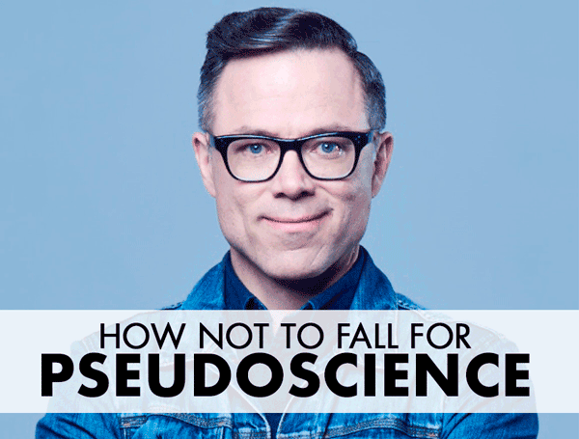
Challenging pseudoscience

Slide 2
What can YOU do?
Recognize that we’re ALL vulnerable to misinformation:

Slide 4
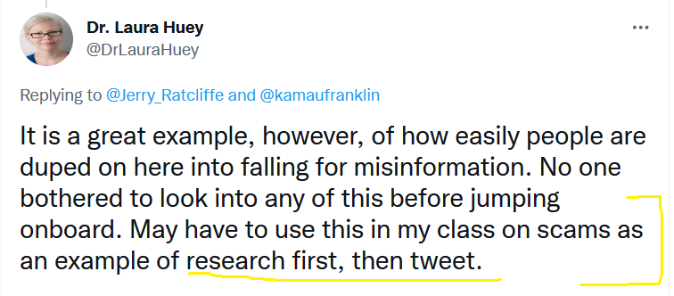
Research before you click:

Slide 7
Learn about resources:

Slide 12
If you’re going to tackle misinformation, remember to be humble, patient, empathetic & interesting.

